Slide 1
Personal information management: what is our digital legacy Drahomira Cupar, Martina Dragija Ivanović, Antonija Grgeč University of Zadar, Croatia
ZBDS Kongres 2024, 18. – 20. September, Maribor, Slovenia

Slide 2
Contents
Introduction
Theoretical background
Terminology
Exploratory study
The aim of the research
Research questions
Results and discussion
Conclusions

Slide 3
Introduction
Increased everyday usage and digital content creation
digital assets can become part of digital legacy
organized and stored as a personal collection for the future use or as part of future digital heritage
exploratory study conducted in Croatia in 2022 as a part of the master thesis titled Organization and preservation of personal digital legacy, defended at the University of Zadar (Grgeč, 2022)

Slide 4
Theoretical background and terminology
an individual possesses two identities: a real-world identity confirmed by official paper documentation and a digital identity created by using the Internet (Park, 2017)
paper is focused on user's experience and habits in organization and preservation of personal digital legacy
concept of personal information management (PIM) from archival sciences
PIM supports everyday actions to acquire, organize, maintain and retrieve information for everyday use (Jones et al., 2006)
digital footprint represents an individual's online presence, provides evidence of their digital and physical identity and records the data left by their interaction in a digital environment (Fish, 2009)
Notes:
ncreased everyday usage and digital content creation
digital assets can become part of digital legacy
organized and stored as a personal collection for the future use or as part of future digital heritage
exploratory study conducted in Croatia in 2022 as a part of the master thesis titled Organization and preservation of personal digital legacy, defended at the University of Zadar (Grgeč, 2022)

Slide 5
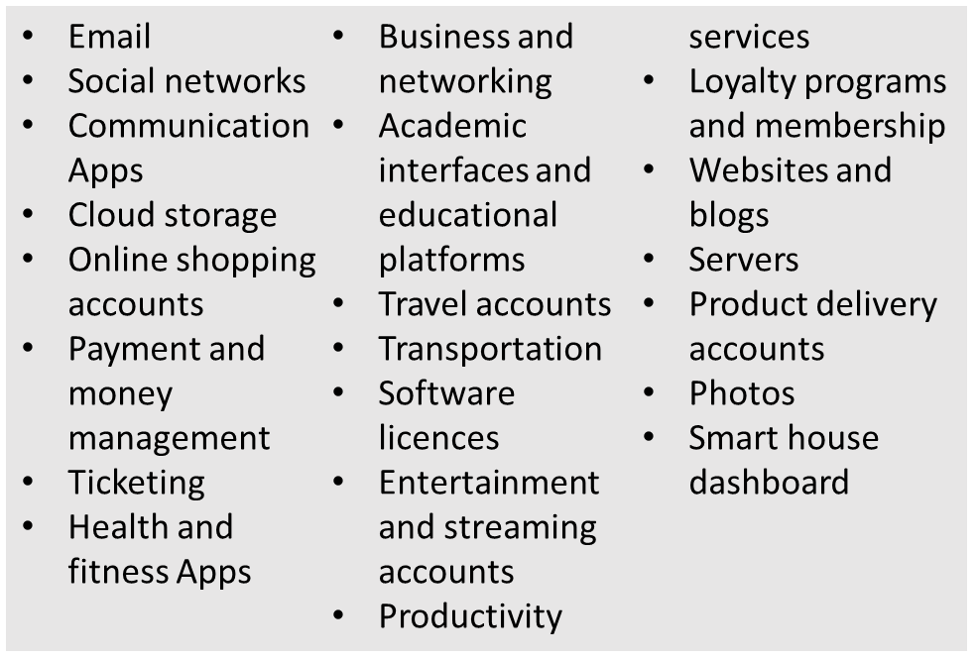
Terminology
personal digital collection functions like an informal personal archive of records containing informal and diverse collections constantly expanding
personal digital archives represent “informal, diverse, and expanding memory collections created or acquired and accumulated and maintained by individuals in the course of their personal lives, and belonging to them, rather than to their institutions or other places of work (Williams, John and Rowland, 2009)
digital property = digital assets = personal digital belongings > DIGITAL LEGACY
digital archives can be created by anyone, digital assets can be owned by anyone – to ensure accessibility there is a necessity to create DIGITAL LEGACY PLAN
Digital property inventory: categories

Slide 6
Exploratory study
The aim of the research
to determine the opinions and attitudes of the participants included in the study about their own personal digital legacy
to examine in what way and to what extent participants organize their personal digital content for the future

Slide 7
Exploratory study
Research questions
Are respondents aware of their own personal digital legacy and what are their attitudes/opinions about the subject?
In what way and to what extent the respondents organize and preserve their personal digital legacy?

Slide 8
Methodology
the survey
the online survey with 229 respondents
analyzed by using means of descriptive statistics
responses collected in the period from February 25th to March 7th, 2022
34 questions: 32 closed-type questions and 2 open-type questions
questions divided into three parts:
general information about respondents,
usage and creation of digital content and
attitudes/opinions about digital legacy; actions and habits in practice

Slide 9
Results
general information about respondents
Female | 77,7 % (178)
Male | 22,3 % (51)
Out of 229 respondents:
56 (24.5%) - aged between 18 and 25
100 (43.7%) between 26 and 35 // most represented age group
41 (17.9%) between 36 and 45,
29 (12.7%) between 46 and 55.
only 5 (2.2%) were over 55 years old and
only 1 over 60 years of age
significantly more female respondents (77.7%) took part in the research, and
only 2.2% of respondents were over 55 years of age

Slide 10
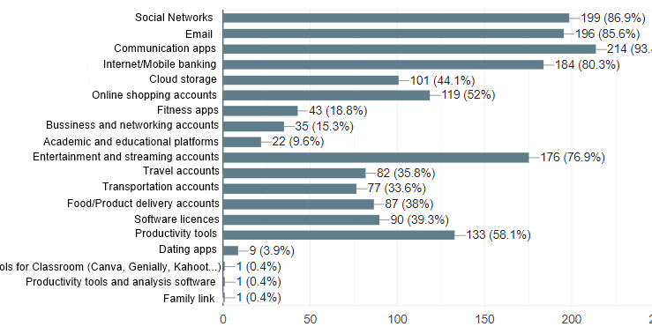
Results
B. usage and creation of digital content
Fig. 1. Online platforms and services actively used in the last 5 years among the respondents

Slide 11
Results
B. usage and creation of digital content
Active usage of social networks and communication accounts
used few times a day
Facebook and Instagram
e-mail and communication accounts (WhatsApp and Viber)
the largest amount of content and data is generated on these platforms
honourable mention: streaming services are often used
note: some of the other platforms or services do not require daily use, but are used as needed, such as Internet and mobile banking, e-commerce accounts, travel accounts, transport accounts or product delivery applications.

Slide 12
Results
B. usage and creation of digital content
Deactivation of an account on a platform or service (when stopped using)
152 respondents (66.4%) never deactivated their user account on the platform or service they stopped using;
74 respondents (32.3%) did deactivated accounts:
mostly on social networks (Facebook, Instagram, Twitter, Snapchat, Tik Tok, Pinterest, LinkedIn, MySpace, MyAnimeList),
other platforms or services such as Amazon, Skype, Pedometer and Uber
3 respondents (1.3%) did not responded

Slide 13
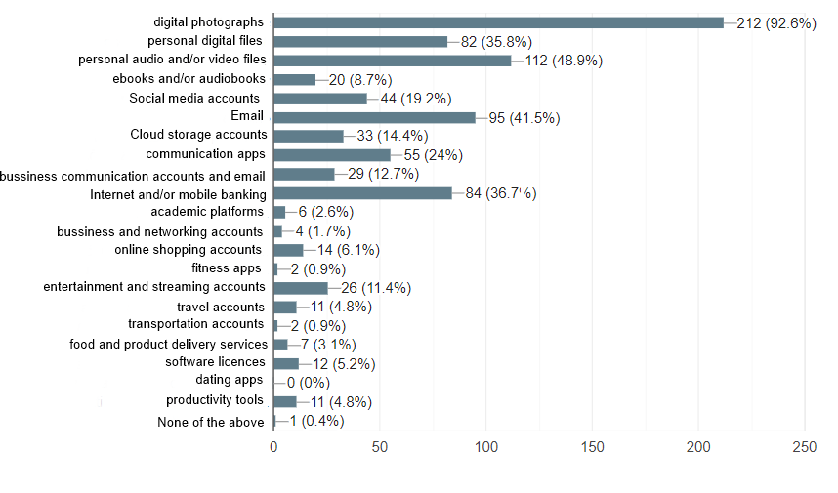
Results
C. attitudes/opinions about digital legacy; actions and habits in practice
Fig. 2. Value of digital files or digital content created: self-assessment
Top 4 digital content worth saving
digital photographs
personal audio/video files
e-mail
Internet banking

Slide 14
Results
C. attitudes/opinions about digital legacy; actions and habits in practice
Preservation for personal use
Internet/mobile banking, communication applications such as WhatsApp and Viber, and e-mail is either important or extremely important to them.
BUT, most often used apps, e.g. Facebook and Instagram - NOT the content that is extremely important for them to preserve
Preservation for the future and heirs

Slide 15
Results
C. attitudes/opinions about digital legacy; actions and habits in practice
DIGITAL CONTENT | delete / make unavailable | preserve / give access | I am not sure
digital photographs | 22 | 176 | 31
personal digital files | 51 | 137 | 41
personal audio and/or video files | 51 | 137 | 41
e-books and/or audiobooks | 91 | 87 | 51
social media accounts | 124 | 49 | 56
email | 88 | 95 | 46
communication apps | 125 | 53 | 51
business communication accounts | 114 | 69 | 46
cloud storage | 110 | 63 | 56
Internet/mobile banking | 91 | 90 | 48
online shopping accounts | 153 | 24 | 52
fitness apps | 162 | 21 | 46
business and networking accounts | 158 | 23 | 48
academic platforms | 152 | 29 | 48
entertainment and streaming accounts | 147 | 37 | 45
travel accounts | 153 | 30 | 46
transportation accounts | 165 | 23 | 41
food and product delivery accounts | 163 | 23 | 43
software licenses | 139 | 45 | 45
dating apps | 173 | 12 | 44
productivity tools | 151 | 29 | 49
Table 1. Respondents’ opinions on providing the access to personal digital content and platforms to the heirs

Slide 16
Results
C. attitudes/opinions about digital legacy; actions and habits in practice
Table 2. Providing access to different types of personal digital files to potential heirs
DIGITAL CONTENT | yes | No | I do not care | I never thought about it
digital photographs | 182 | 12 | 12 | 23
digital files | 136 | 35 | 29 | 29
music files | 94 | 46 | 62 | 27
video files | 134 | 33 | 33 | 29
e-books | 71 | 58 | 66 | 34
audiobooks | 67 | 60 | 69 | 33
social media accounts | 56 | 86 | 53 | 34
email | 87 | 62 | 45 | 35

Slide 17
Results:
Digital legacy plan
Plans for preserving any of digital files and digital content in the event of their death,
95.2% answered NO
11 respondents (4.8%) answered YES

Slide 18
Conclusions
digital content and digital artifacts have become equally important for inheritance as the material possessions are
respondents in our study give value to the content they create, but not all is worth saving for future heirs
most of them don’t have a digital legacy plan, but this study gave them enough information to start thinking and act towards building it
although with certain limitations, this study gives valuable insights to the attitudes and opinions towards preservation of digital legacy among citizens in Croatia

Slide 19
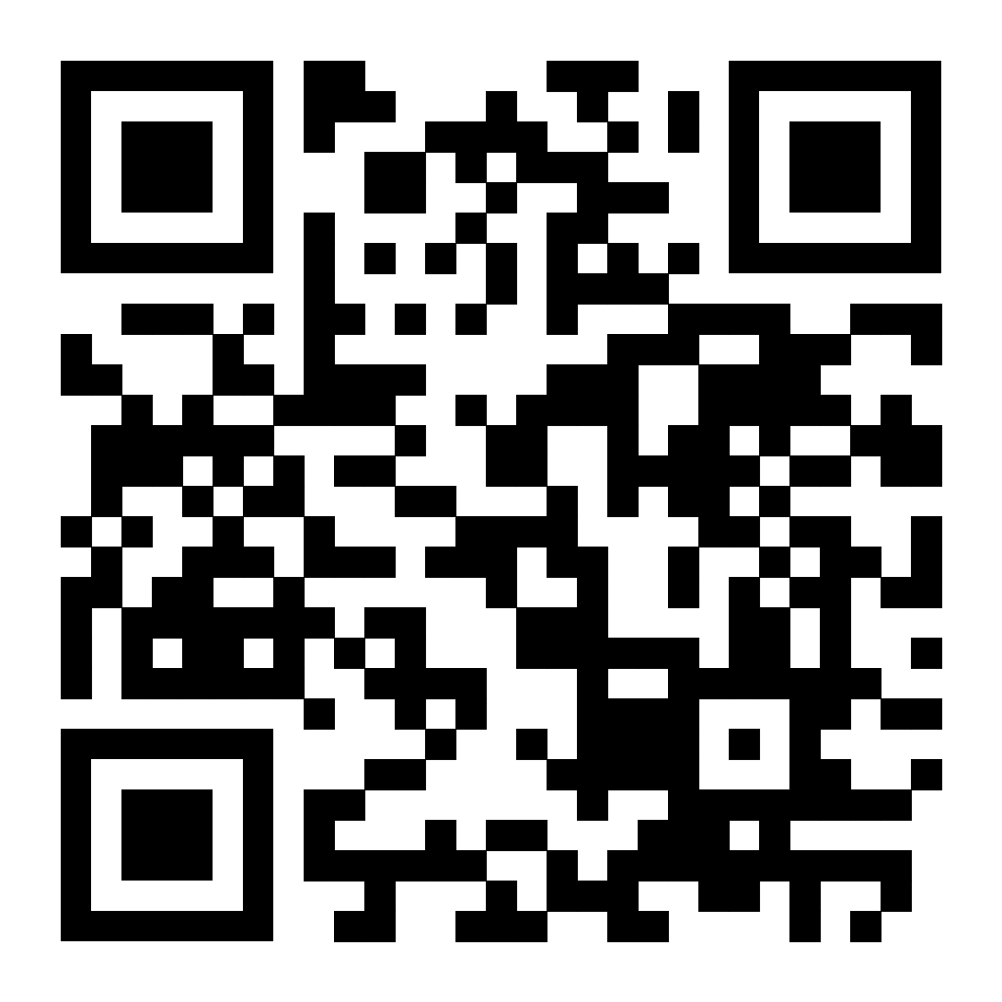
Published paper in LIDA 2023 proceedings:
Cupar, Drahomira, Ivanović, Martina Dragija, and Grgeč, Antonija. ‘Personal Digital Legacy: Findings from an Exploratory Study Among Citizens of Croatia’. 1 Jan. 2023 : 517 – 540.

Slide 20
Hvala na pažnji!
Drahomira Cupar, dcupar@unizd.hr
Martina Dragija Ivanović, mdragija@unizd.hr
Antonija Grgeč , grgec.antonija@gmail.com University of Zadar, Croatia

