Slide 1
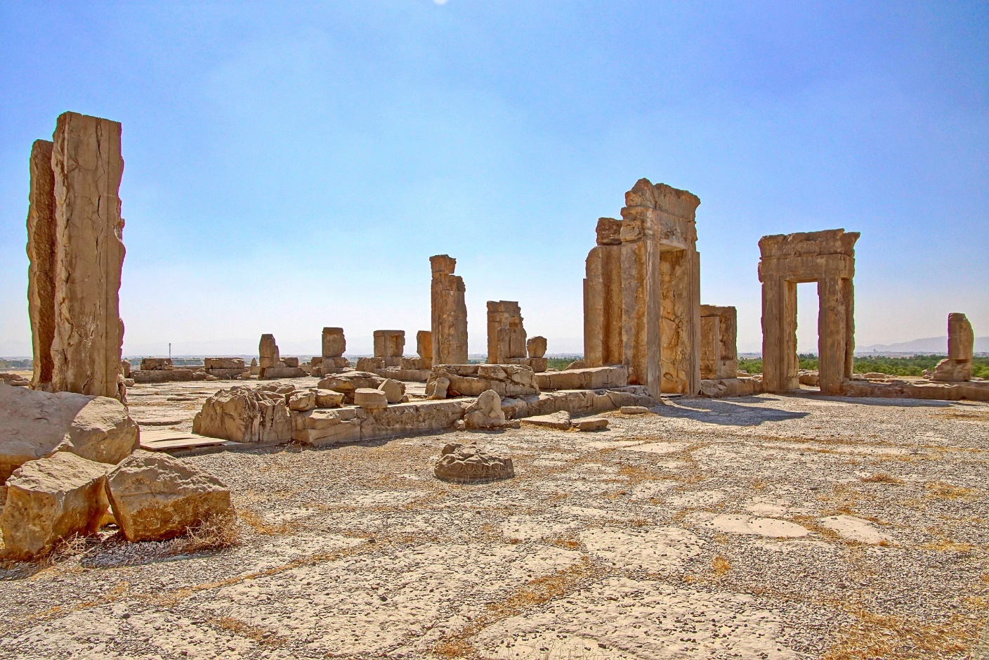
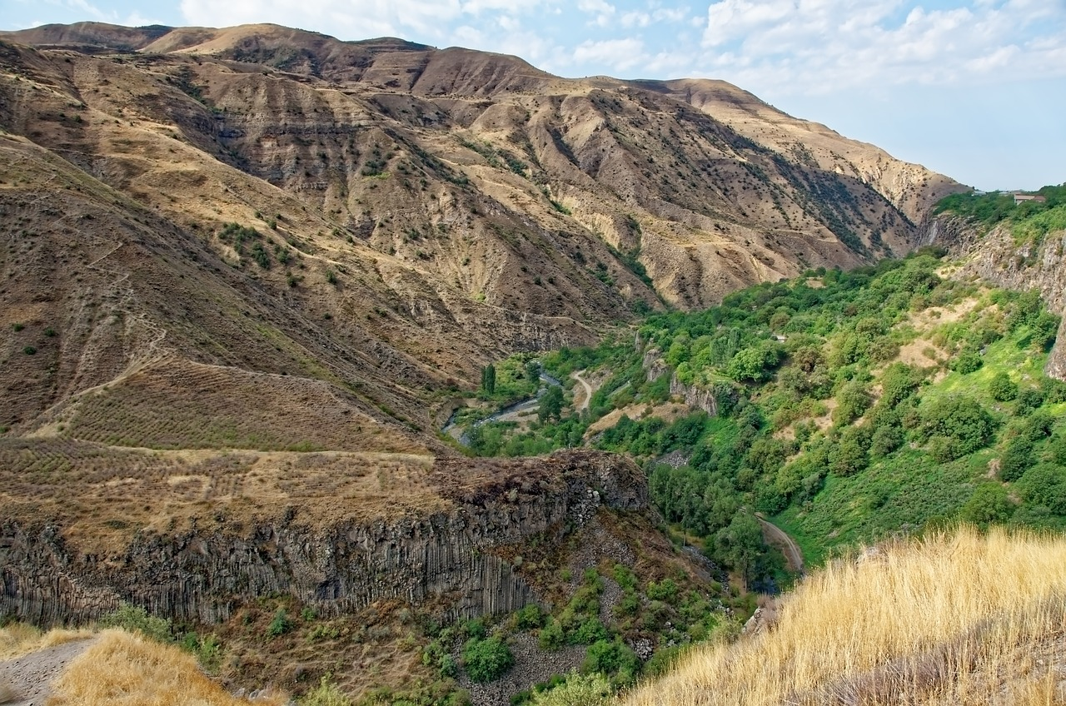
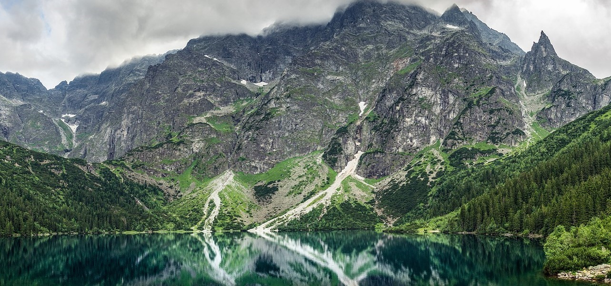
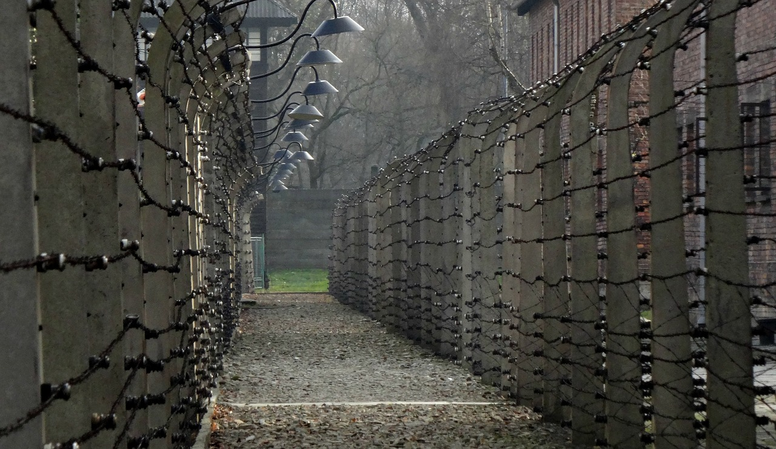
That means there are incredible stories to tell…
More than a thousand years of wandering from India, through Persia, Armenia, Turkey, Greece, the Balkans; Romania, Hungary, Germany, Poland, Russia, Sweden …
Bagir Kwiek reads "The Old Man and the Rooster"

Slide 2
How to make the library a sanctuary, reading embassy, and safe space for Romani users
Elisabet Rundqvist

Slide 3
When you leave today…
You have reflected on your own prejudices and beliefs.
You have an understanding of the frameworks, conventions, the European Roma strategic framework, and the Slovenian approach.
You have had an opportunity to discuss, compare and learn from peers.
You have a five-step model for involving the Roma community in your library.
You have (new?) insights about the Roma population.
Target output: Tools for drafting the first steps of a local strategy to implement in your own library, based on examples from Sweden and Slovenia.
Disclaimer: Some images and language used here are solely for educational purposes and may be inappropriate in other contexts.
…

Slide 4
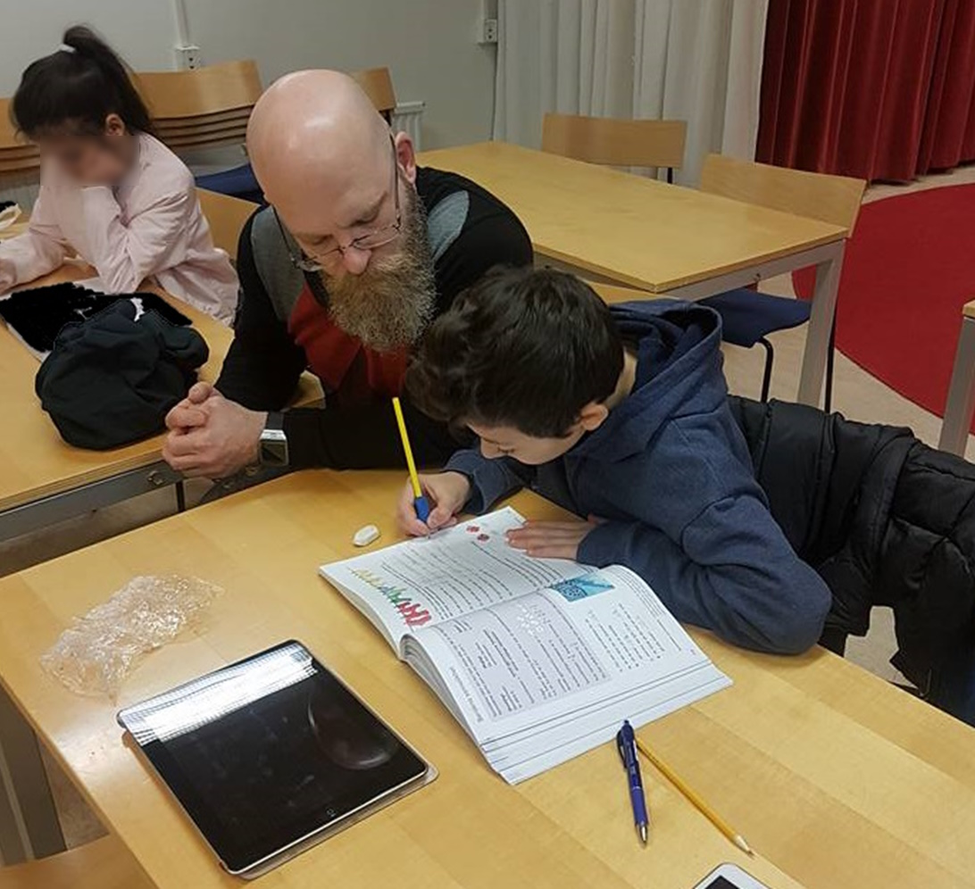
…
Facts or unconscious beliefs?
Photo: Elisabet Rundqvist, KB
Photo: Gävleborgs Romska Internationella Förening

Slide 5
Sanctuary
…
Embassy
Safe space
Photo: Elisabet Rundqvist, KB

Slide 6
Discuss
…
How much factual knowledge do you have about the Roma groups?
What stereotypes are connected to the Roma people?
How are Roma people perceived and received in your library?
Reflect on the words
Sanctuary
Embassy
Safe Space

Slide 7
The Roma are Europe’s largest ethnic minority. Of the estimated 10 to 12 million Roma living in Europe, approximately 6 million are citizens or residents of the EU.
AI and DIKKO

Slide 8
https://www.enar-eu.org/about/antigypsyism/

Slide 9
Council of Europe: Framework Convention for the Protection of National Minorities (ETS No. 157)
Considering that a pluralist and genuinely democratic society should not only respect the ethnic, cultural, linguistic and religious identity of each person belonging to a national minority, but also create appropriate conditions enabling them to express, preserve and develop this identity;
Considering that the creation of a climate of tolerance and dialogue is necessary to enable cultural diversity to be a source and a factor, not of division, but of enrichment for each society;
Article 1 The protection of national minorities and of the rights and freedoms of persons belonging to those minorities forms an integral part of the international protection of human rights, and as such falls within the scope of international co-operation.
https://www.coe.int/en/web/conventions/cets-number-/-abridged-title-known?module=treaty-detail&treatynum=157

Slide 10
Monitoring, sixth cycle: Slovenia
The rules in the Convention also apply to the members of the Roma community living in Slovenia, pursuant to the Constitution and other legislative acts of Slovenia.
Slovenia guarantees special constitutional rights to members of national communities and the Roma community, namely: it guarantees not only to individual members of minorities but also to communities, representation in national or local representative bodies, special rights regardless of the number of members of the minority, and has expressly undertaken to support, materially and morally, the exercise of such rights.
[..] while the collective rights of Roma are regulated by a special Act and sector-specific legislation.
https://www.coe.int/en/web/minorities/slovenia

Slide 11
The European Charter for Regional or Minority Languages
The European Charter for Regional or Minority Languages is the European convention for the protection and promotion of languages used by traditional minorities.
The Charter sets out a number of specific measures to promote the use of regional or minority languages in public life. These measures cover the following fields: education, justice, administrative authorities and public services, media, cultural activities and facilities, economic and social activities and transfrontier exchanges.
Each Party undertakes to apply a minimum of thirty-five paragraphs or sub-paragraphs chosen from among these measures, including a number of compulsory measures chosen from a "hard core". Moreover, each Party has to specify in its instrument of ratification, acceptance or approval, each regional or minority language, or official language which is less widely used in the whole or part of its territory, to which the paragraphs chosen shall apply.
https://www.coe.int/en/web/conventions/full-list?module=treaty-detail&treatynum=148
https://rm.coe.int/november-2022-revised-table-languages-covered-english-/1680a8fef4

Slide 12
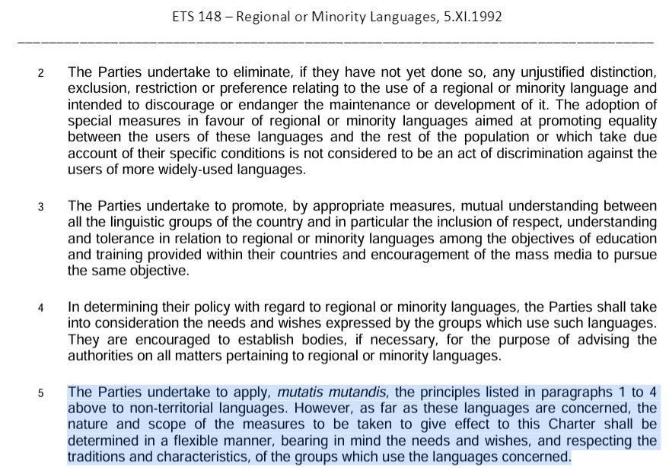
Slovenia
'Mutatis mutandis' translates to 'all necessary changes having been made' or 'with the necessary changes'. The phrase mutatis mutandis indicates that whilst it may be necessary to make some changes to account for different situations, the main point remains the same.

Slide 13
https://commission.europa.eu/strategy-and-policy/policies/justice-and-fundamental-rights/combatting-discrimination/roma-eu/roma-equality-inclusion-and-participation-eu_en#eu-roma-strategic-framework-for-equality-inclusion-and-participation

Slide 14
National Programme of Measures for Roma of the Government of the Republic of Slovenia for the Period 2021–2030
The Roma community in Slovenia is very diverse, as are the situation and socio-economic conditions in the lives of its members. One must be aware of this diversity, especially when drafting and implementing measures. Differences can be detected even between families in a settlement with the majority Roma population, between individual settlements in a municipality, between municipalities in a region, as well as between regions.
https://commission.europa.eu/document/download/408177c9-7a81-4541-bf59-c1286bffe78a_en?filename=slovenia_-_national_roma_strategic_framework_21_30_en.pdf

Slide 15
National Programme …
6.2.1 Strategic objective: Promoting specific, active cultural activity and social inclusion in the culture of members of the Roma community, in accordance with the cultural needs they express.
Indicator: Number of approved projects.
OBJECTIVE 6.2.1.1 Preservation, development and presentation of the culture, language and identity of the Roma community, greater awareness of residents of Slovenia about the culture and language of minority communities and greater accessibility of cultural goods for individuals belonging to the Roma community.

Slide 16
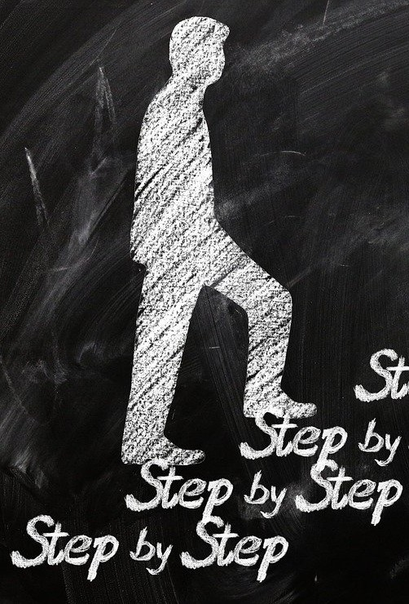
Photo: Elisabet Rundqvist, KB

Slide 17
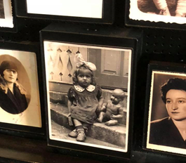
Step 1: Increase your own knowledge
Organise training days to gain knowledge and insights about the conditions and situations of the Roma group.
Read! Search for facts, reports, books, etc.
Educate yourself on your own or in workplace group activities.
Don’t forget cultural expressions! (Music, performances, art, handicraft etc.)
Invite Roma people!
Invite Roma to describe themselves, their group, culture, the history of Roma in the country, and the local history.
Find out who lives in your local community!
Conduct assessments of local needs, educational levels, and other factors that may influence library work.
Photo: Kurt Magnusson /DIKKO

Slide 18
Step 1: Increase your own knowledge
What dialects are spoken in your local community?
Arli/Gurbeti, Lovari/Kelderash, more?
Intersectional perspective!?
Some Roma are more vulnerable than others (e.g., women, LGBTIQ+, older people, people with disabilities, certain socioeconomic groups, etc.)
Youth perspective
What is the situation for young Roma, children, teens, young adults?
Political governance versus minority rights
Are there conflicts of interest?
https://www.nm.cz/historicke-muzeum/romske-zeny-a-jejich-osudy-v-kontextu-dejin-kazdodennosti-dejin-zen-a-pametovych-instituci

Slide 19
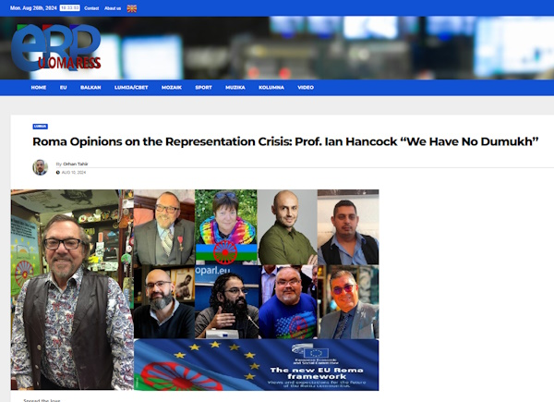
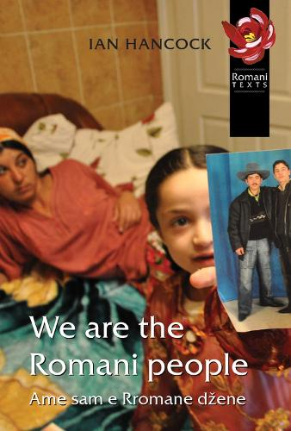
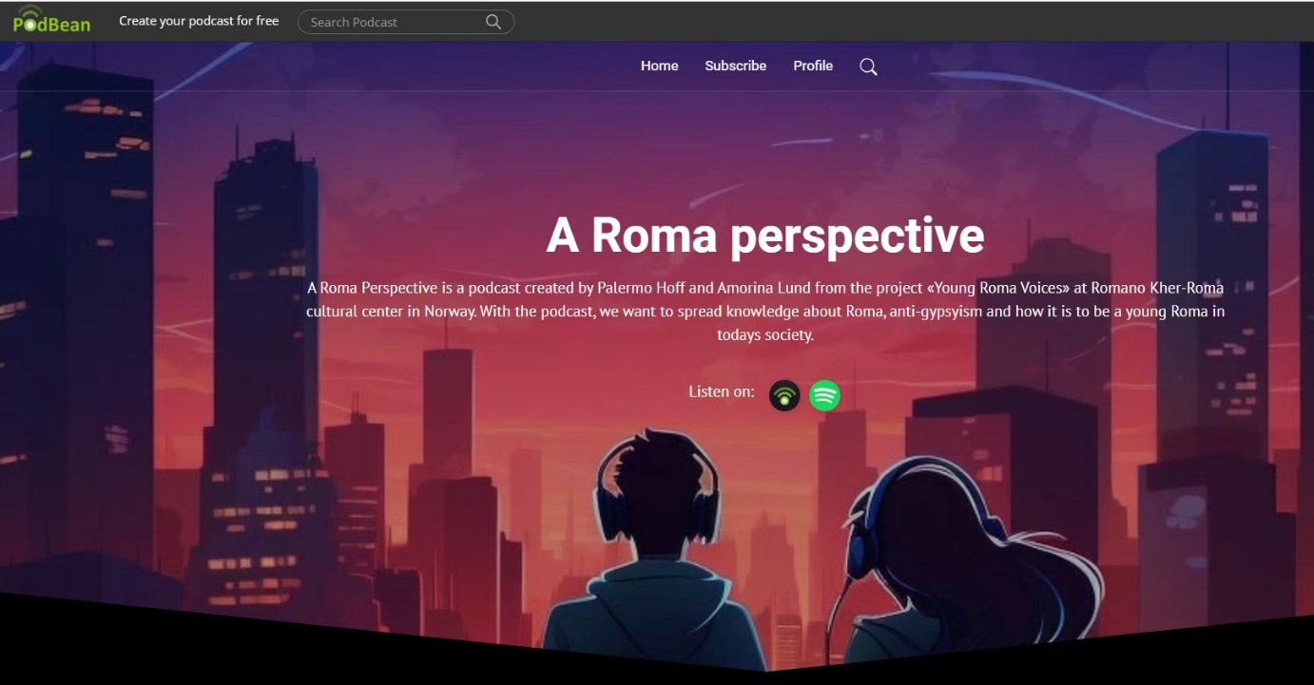
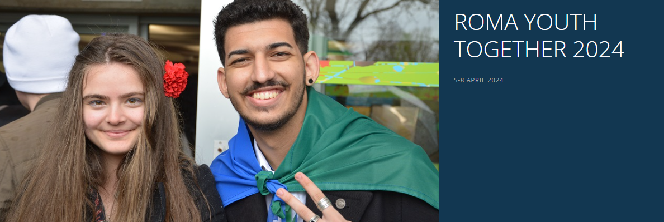
https://www.romanistanpodcast.com/
https://euromapress.com/roma-opinions-on-the-representation-crisis-prof-ian-hancock-we-have-no-dumukh/
ISBN: 9781902806198
https://www.coe.int/en/web/no-hate-campaign/roma-rights1
https://aromaperspective.podbean.com/

Slide 20
Unintentional discrimination

Slide 21
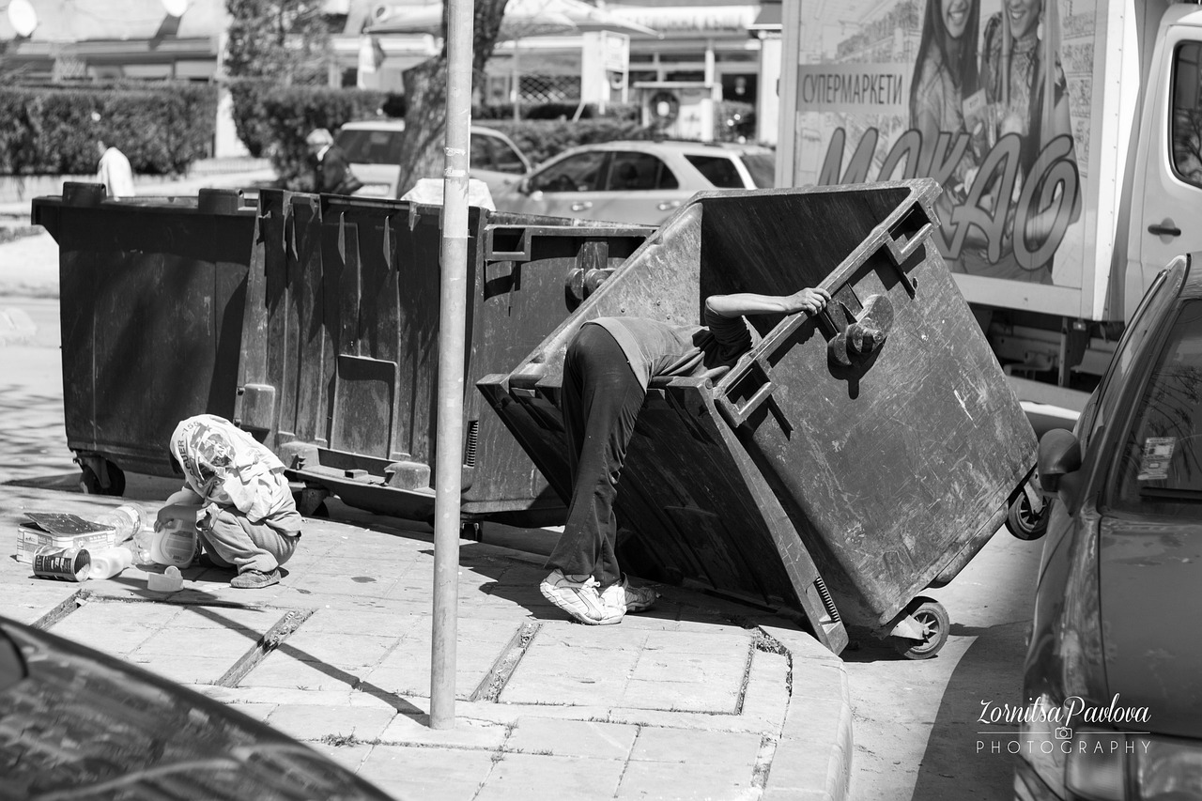
Unintentional discrimination
Stems from positive intentions but often arises from unconscious norms, biases, and stereotypes or lack of knowledge / ignorance
When an apparently harmless portrayal inadvertently reinforces a prejudice, it can result in a perceived microaggression against the group.
This applies to all grounds of discrimination, including:
Ethnicity
Disability
Gender
Gender identity or expression
Religion or belief
Sexual orientation
Age
Socioeconomic background
https://pixabay.com/sv/photos/luffare-romer-zigenare-beh %C3%A5llare-531201/
Luffare (tramp) “Zigenare (gypsies)”, Romer as search words! (2014)

Slide 22
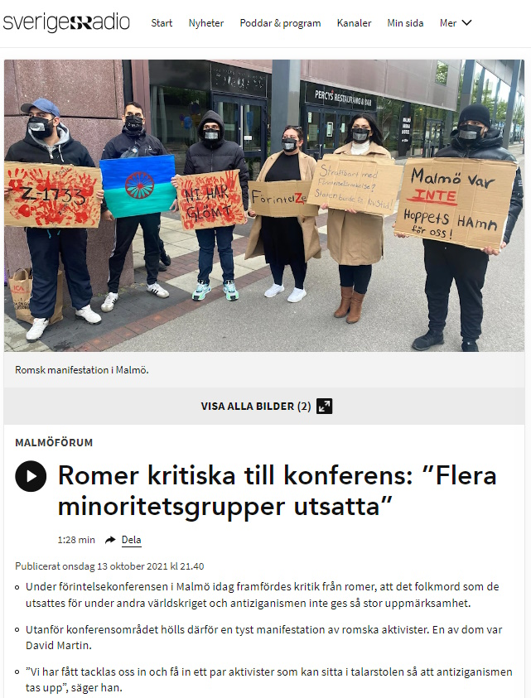
https://www.vaticannews.va/en/world/news/2022-01/holocaust-memorial-day-dialogue-creates-connection-and-understa.html

Slide 23
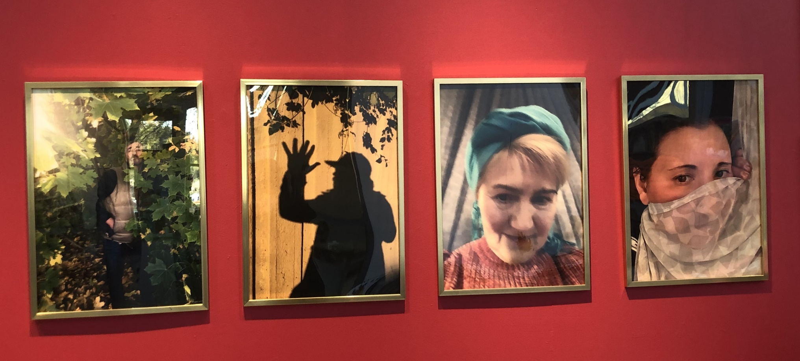
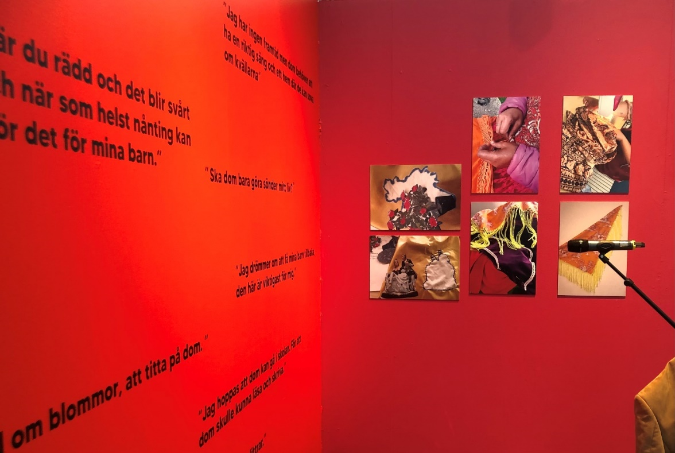
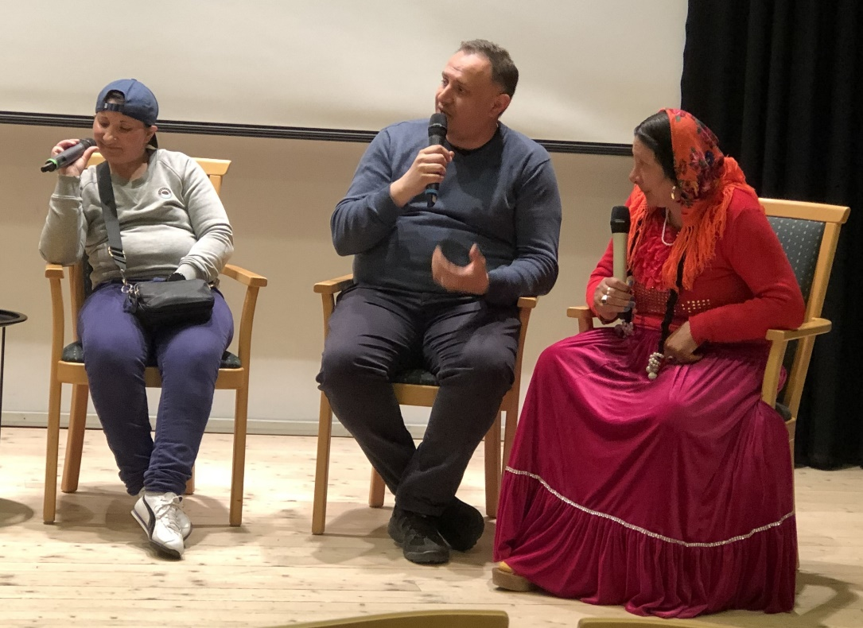
Have I unintentionally discriminated?
…
Context
Is there context, or is it missing?
Relevance
Within the context, what does the image/text/other media convey?
Agency
Who is active? Who is passive?
Representation
Who is visible? Who is not? Who gets to represent what? Does one person always represent their "area of discrimination"?
Authority / Power:
Who does what? Who does not have authority or power?
Photos: Elisabet Rundqvist, KB

Slide 24
Step 2: Why should we do this?
Set goals - involve all library staff. “Why are we doing this?”
Libraries have a broad democratic mission
Can the library fulfil the broad mission?
What image does the library want to communicate?
What is the library’s USP*?
Temporary and long-term efforts: What if long-term funding isn’t available? Building trust takes time...
Who has the resources?
Who has the power to make decisions?
Envision what needs to be done
Envision a modern library where Roma are naturally included in the planning of activities.
The library should stand for the vision and ensure it meets legislation and/or relevant strategies, such as Roma strategic framework.
Collaborate and share experiences with other libraries!
* USP = Unique selling point

Slide 25
Step 2: Why should we do this?
Integrate planning into regular operations; align activities for Roma with other library activities.
Include activities for Roma in annual planning.
Make sure important dates are in the planning calendar:
January 27th Holocaust Remembrance Day
April 8th International Roma Day
May 6th Ederlezi (Durdevdan)
May 16th Roma Resistance Day
May 24th Kali Sara (patron saint of Romani people)
August 2nd Roma Genocide Remembrance Day

Slide 26
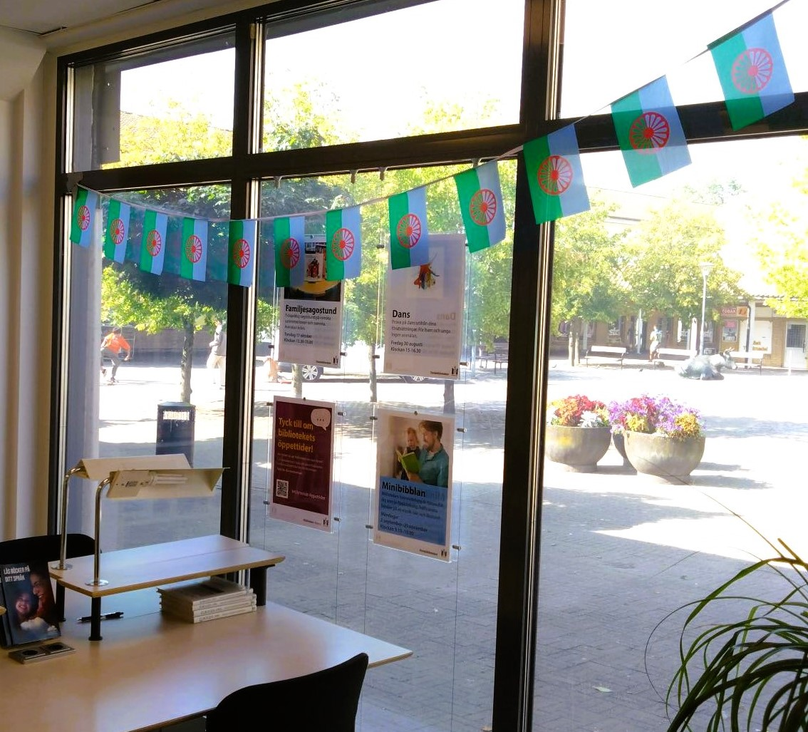
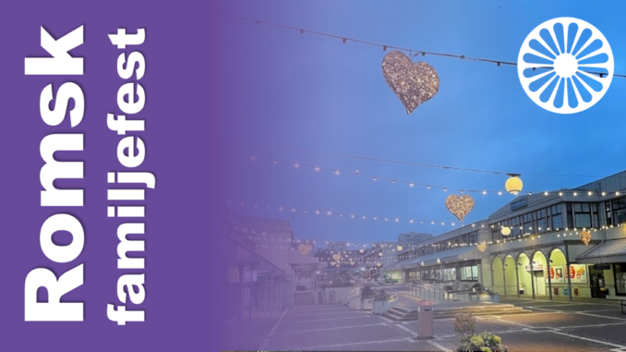
Step 3: Start! Make Roma visible
Raise the flag, display the literature - put it on a separate shelf or mark clearly.
Organise events, exhibitions.
Make Roma visible!! (In the front of the library)
Create sanctuary for young people and children
Invite them to conversations about what's interesting and/or important.
Make sure that parents feel safe with their children being in the library.
Offer activities for all ages!
Identify young ambassadors.
Photo: Florida Lydia Pavlovska Oxie Library, Malmö
Representation—whose voices are being heard?
Biskopsgården Library, Gothenburg

Slide 27
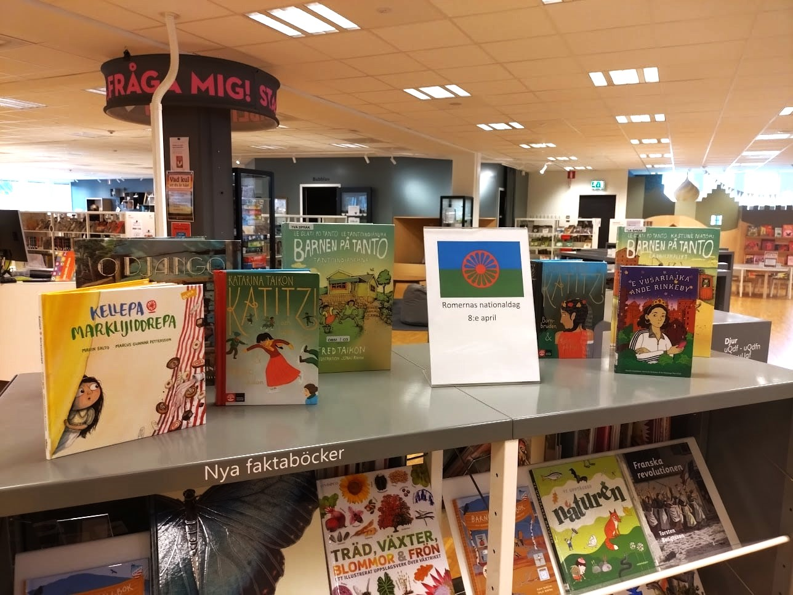
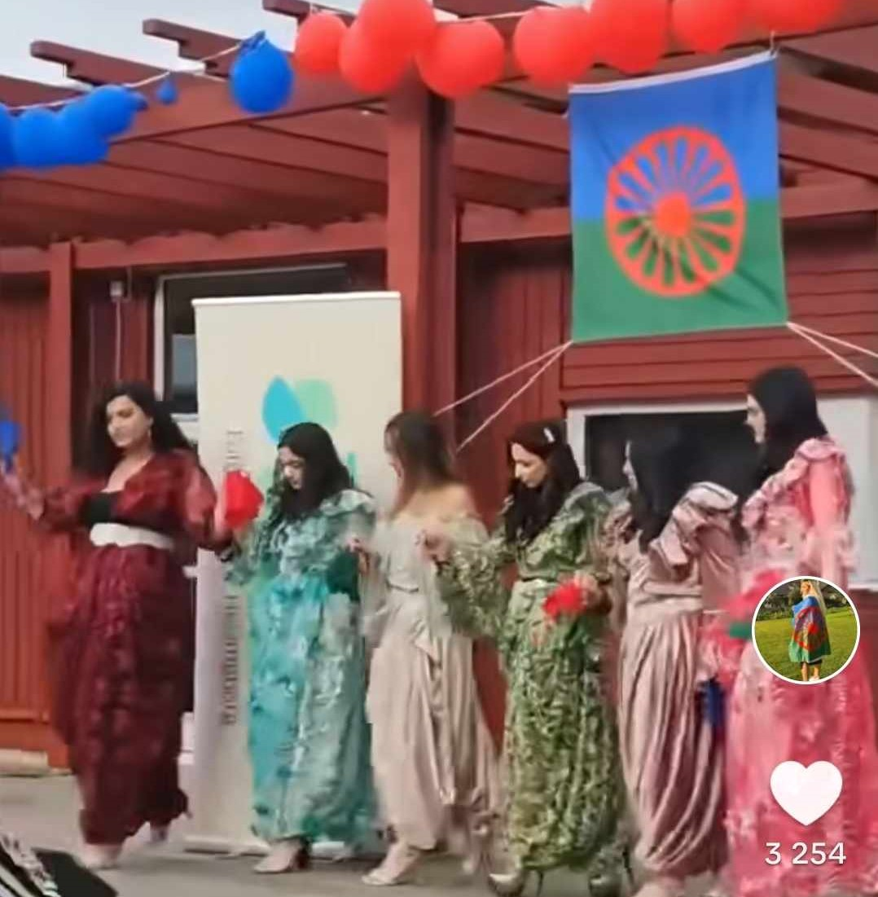
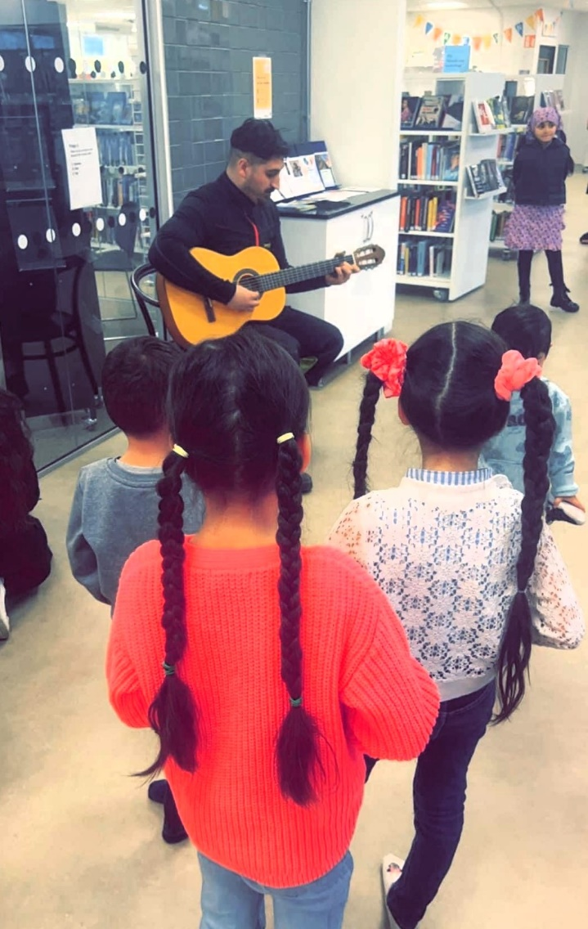
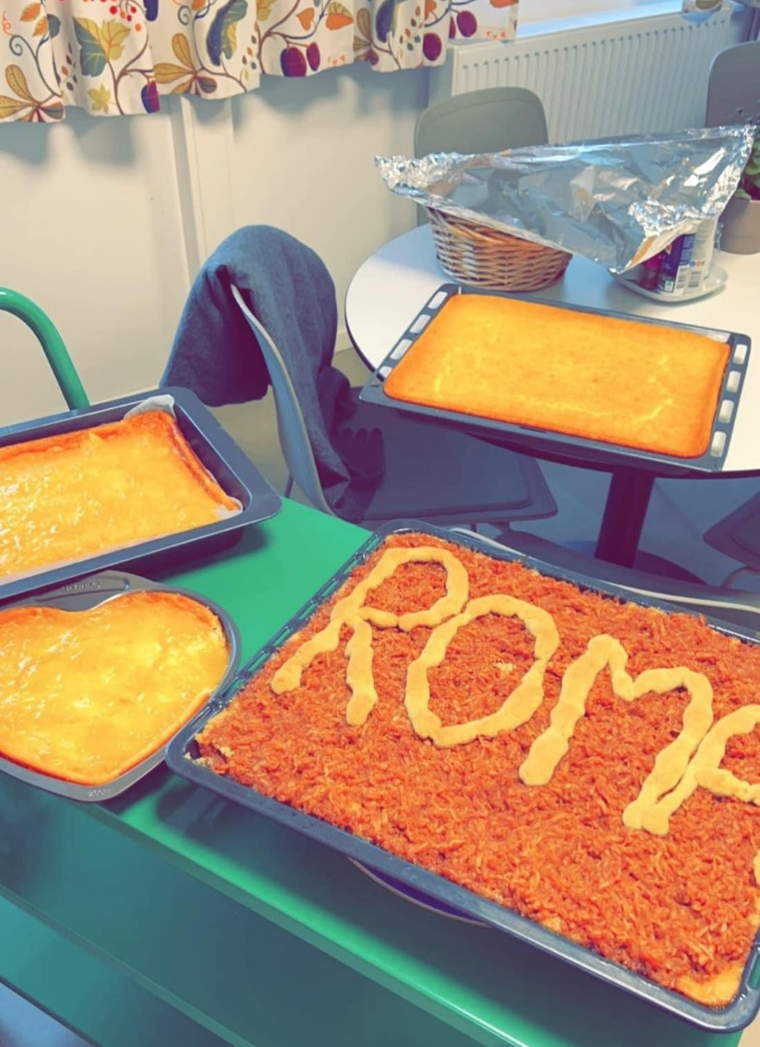
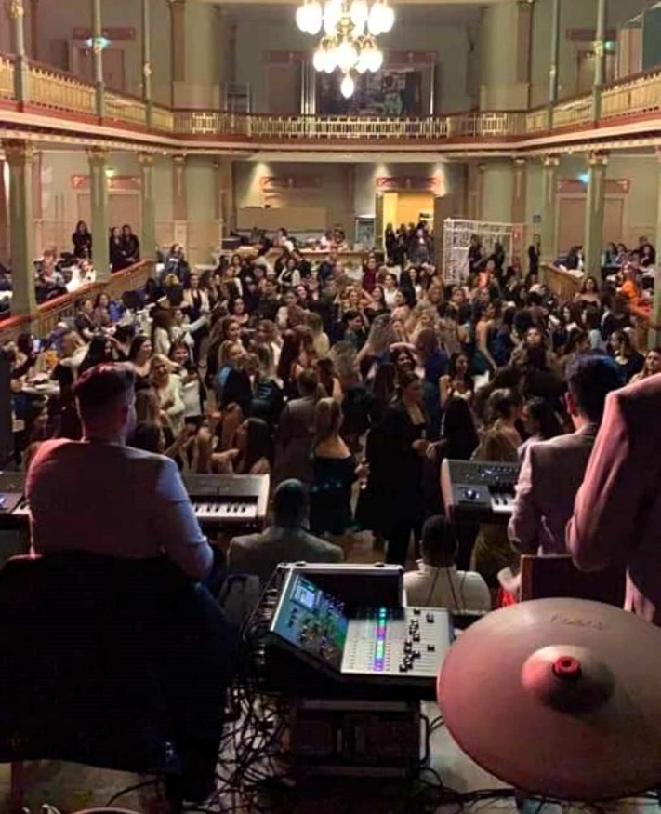
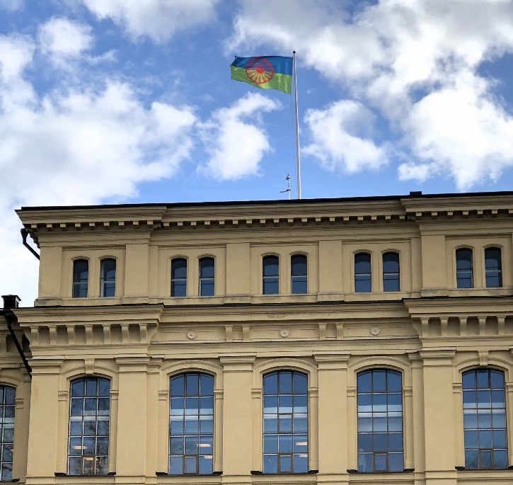
8th of April - International Roma Day
Photo: Åsa-Maria Berg Levinsson, Borås Public Library
Photo: Esma Eselovski-Gudinci (private)
Photo: Florida Lydia Pavlovska, Oxie Public Library
Photo: Elisabet Rundqvist, KB
Photo: National Library of Sweden

Slide 28
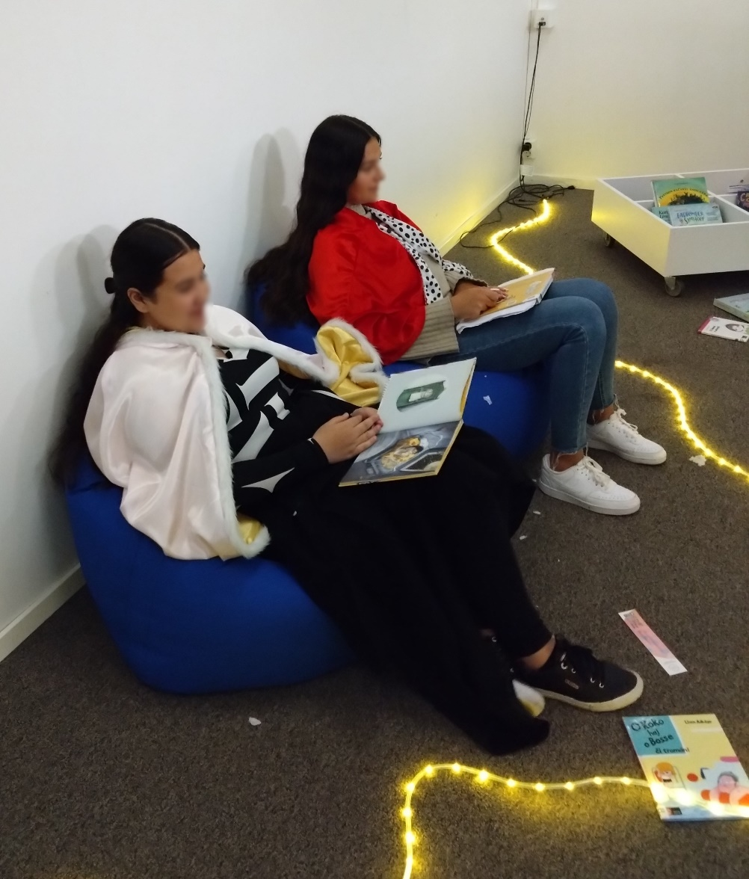
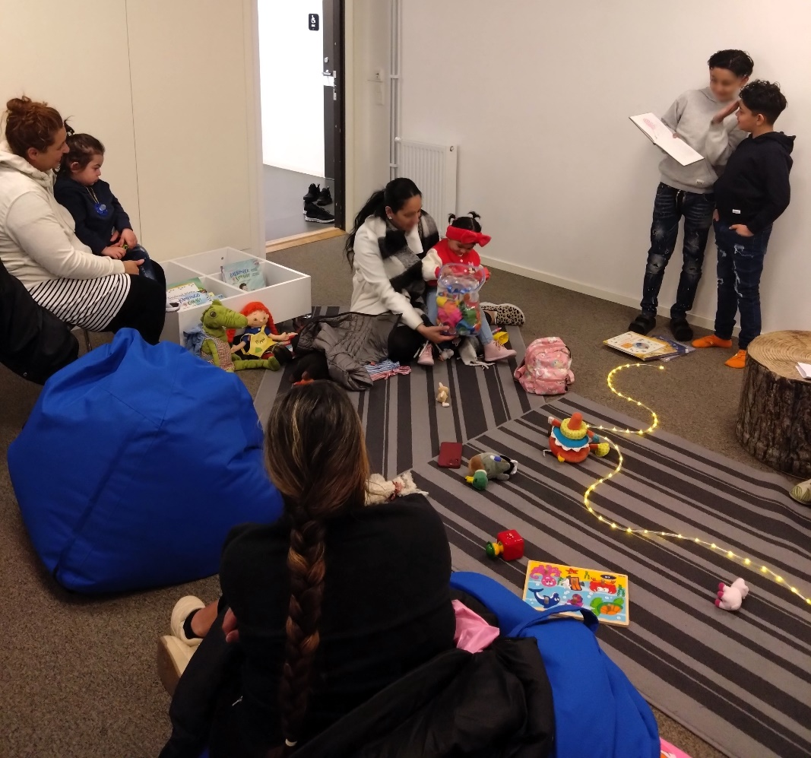
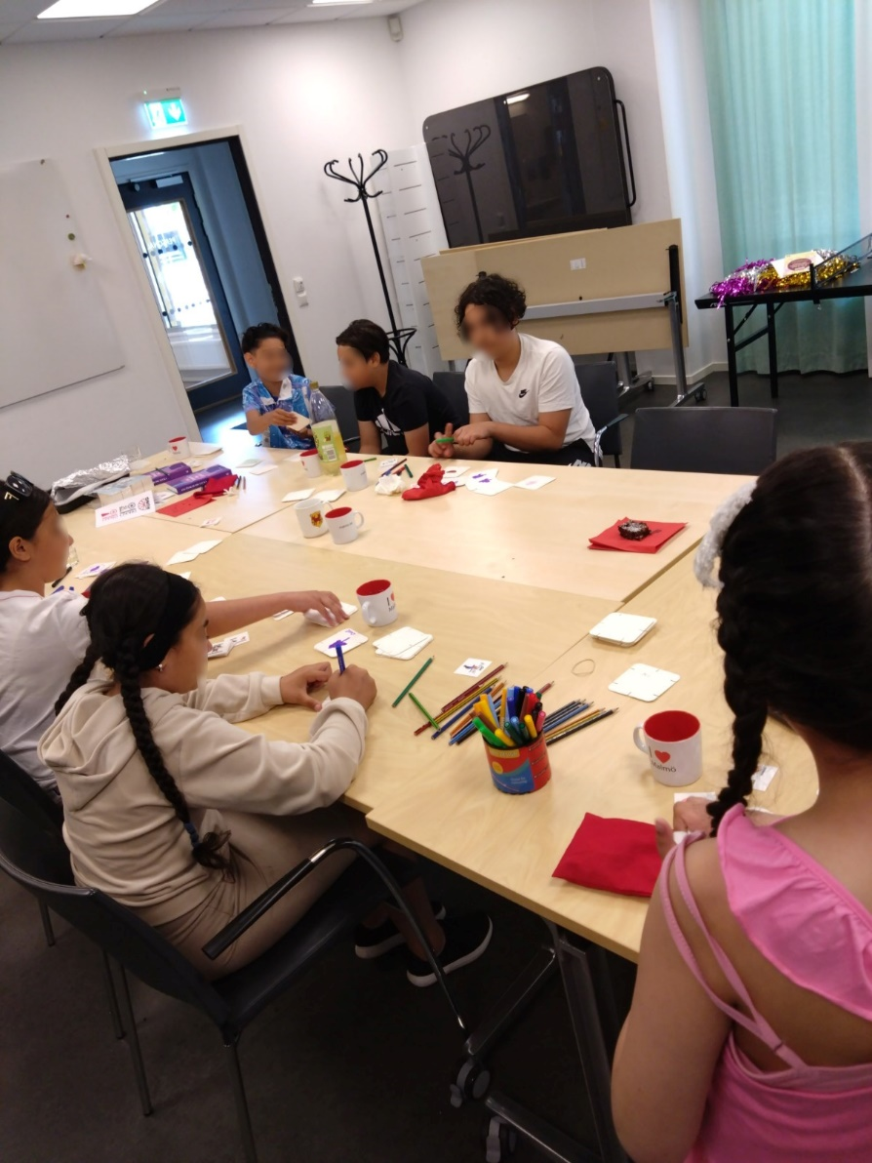
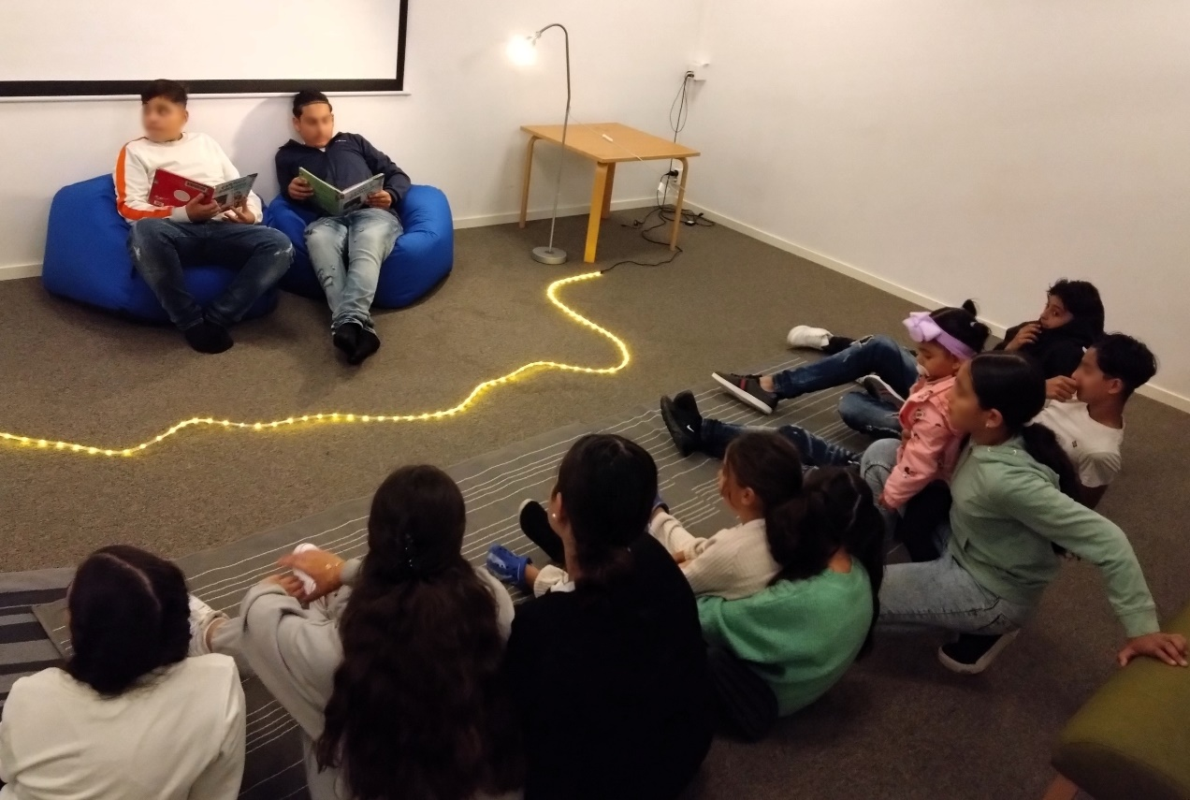
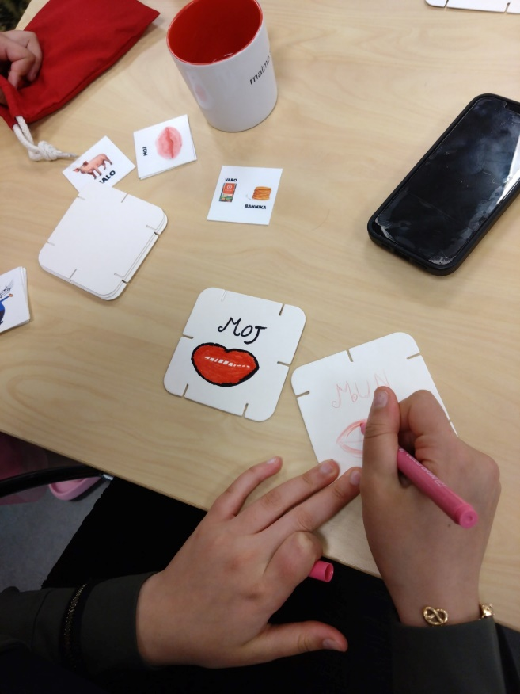
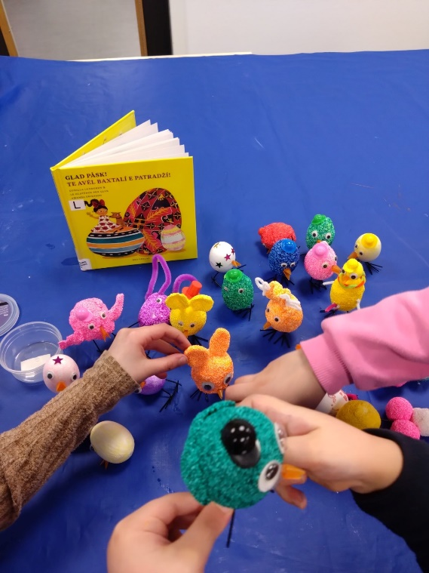
Family activities, Oxie Public Library
Photos: Florida Lydia Pavlovska

Slide 29
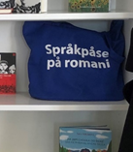
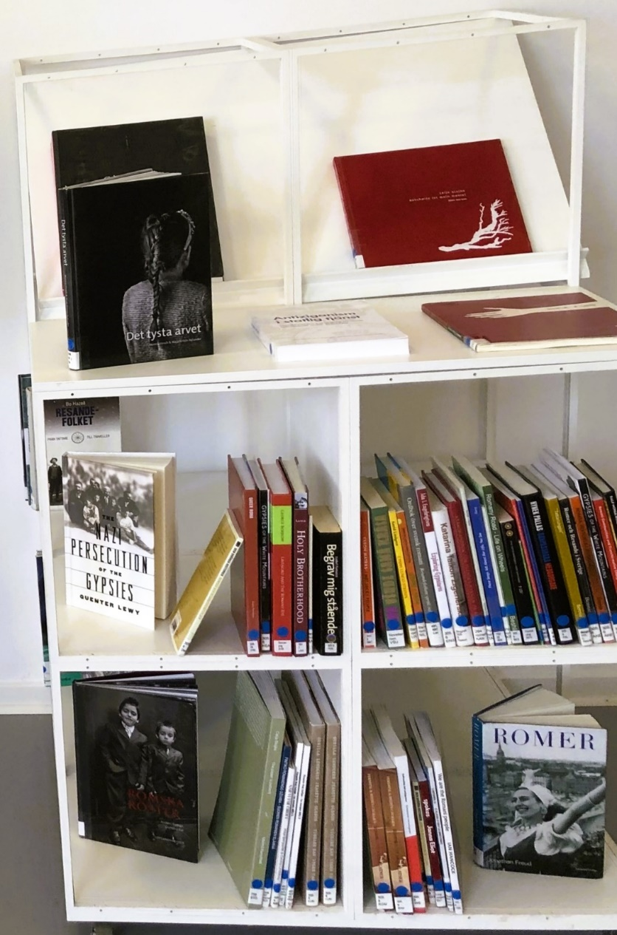
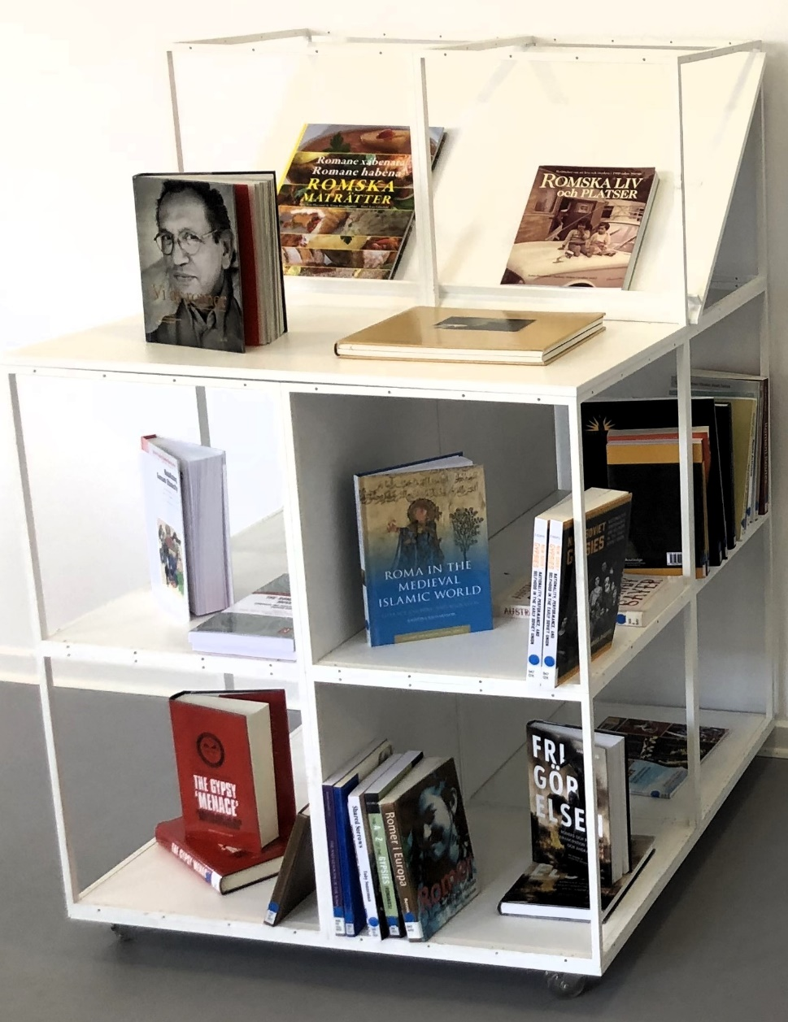
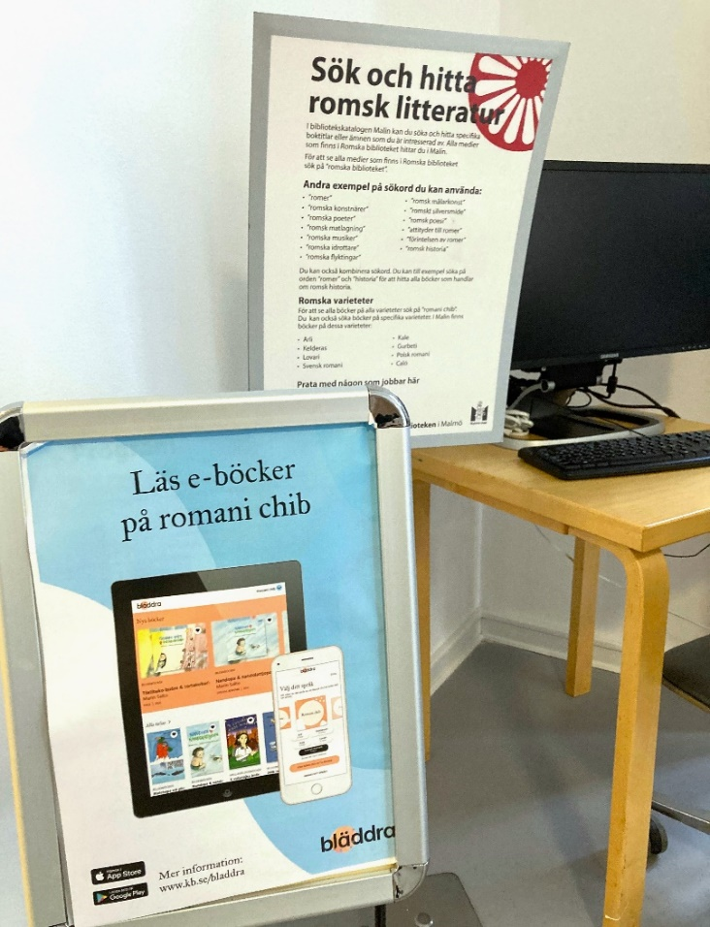
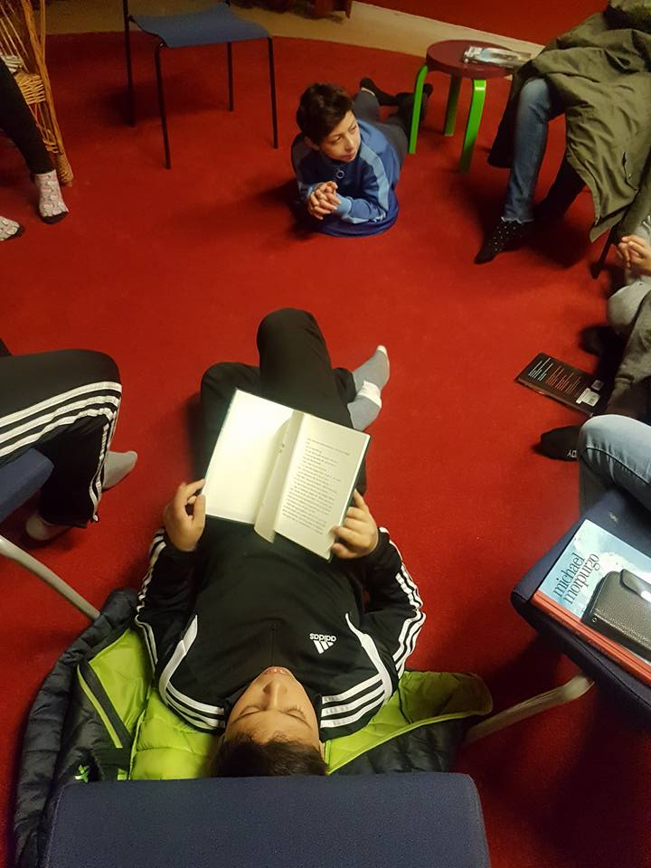
Learning history and culture
Photo: Elisabet Rundqvist, KB
Photos: Elisabet Rundqvist, KB
Photo: Gävleborgs Roma Internationella förening

Slide 30
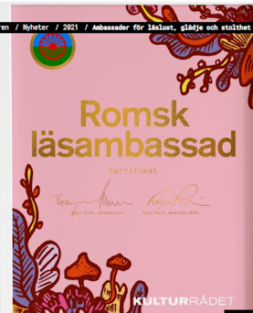
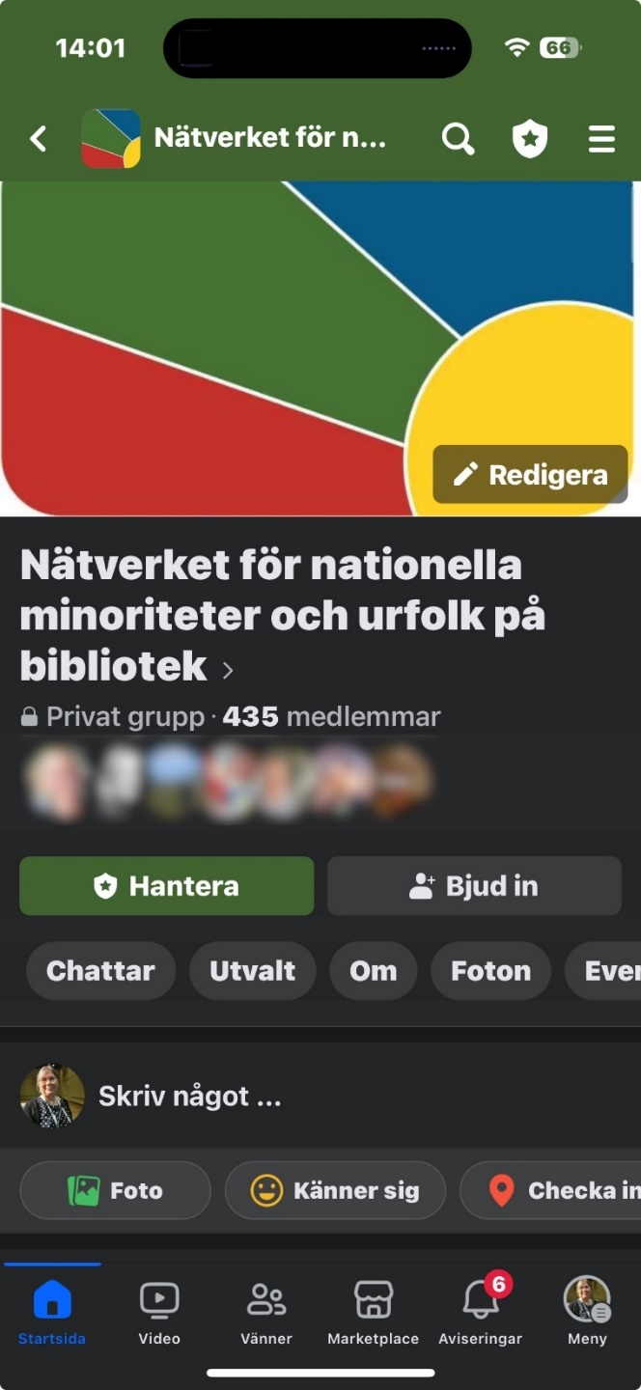
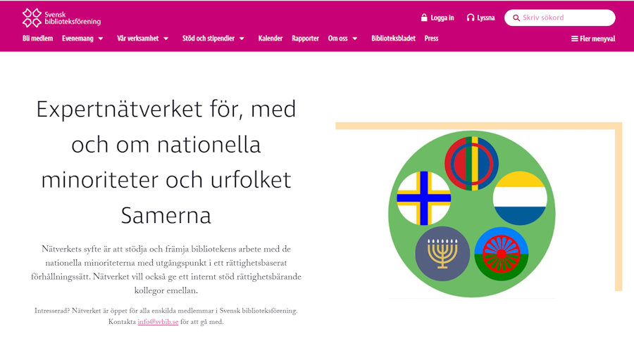
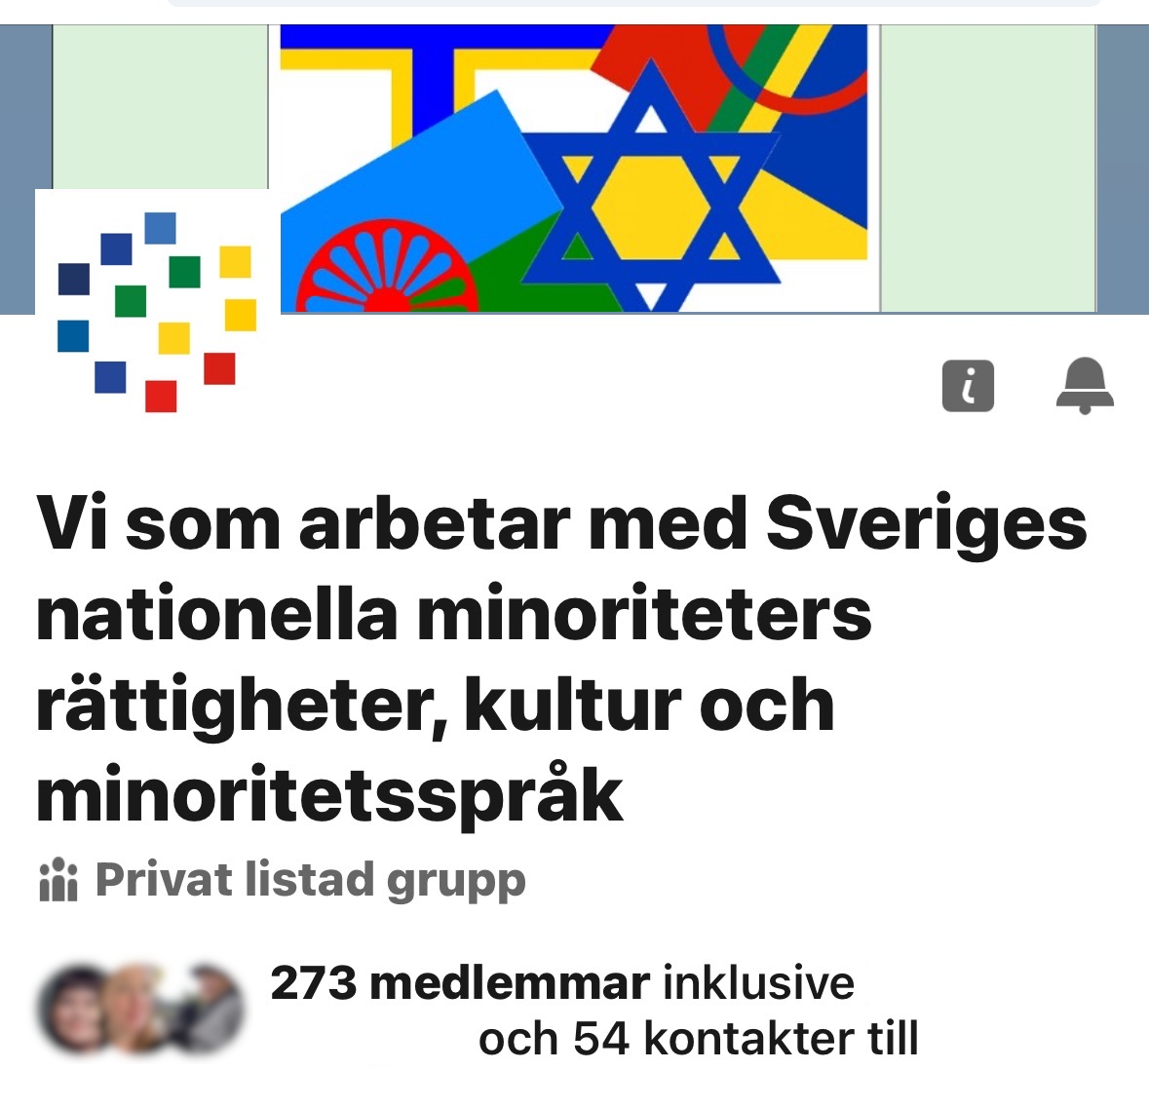
SHARING
Reading embassy network
Swedish Library Association

Slide 31
Discuss / share
…
Share your examples!
What has worked? And what hasn’t?
What can you change immediately in your library?
Ways of sharing?
SHARING

Slide 32
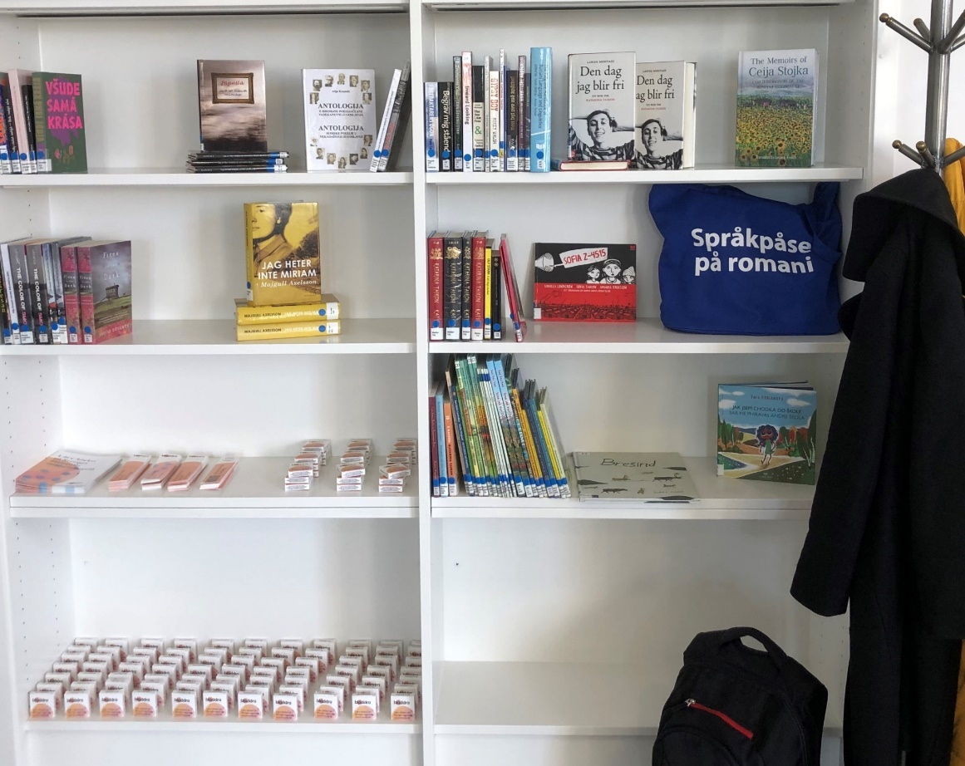
Step 4: Build trust
Start contacting the group, invite them in!
Find out what days and times suit the Roma and adapt.
Show the Roma space
Collect the Roma content in one or several clearly marked spaces
Ask for positive role models nationally or locally and highlight them in the activities.
Use young people as an entry point—have youth ambassadors!
Adopt local strategies for making Roma feel welcome.
Photos: Elisabet Rundqvist, KB
https://www.romskehlasy.eu/en/home/

Slide 33
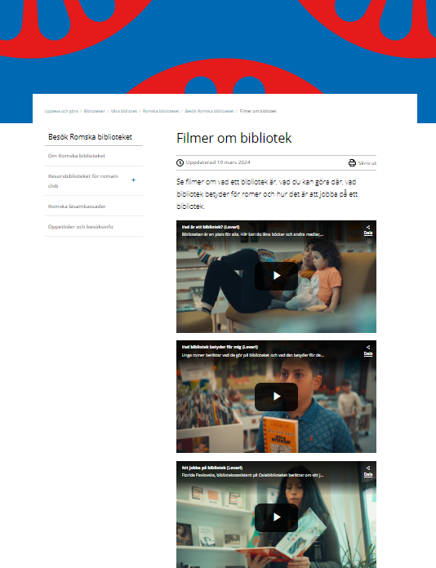
Voices - videos
Malmö City Library produced three videos with the Romani population as target audience:
What is a library?
What the library means for me (voices)
Working in a library
Audio in Lovari, with subtitles available in Lovari and Swedish
https://malmo.se/Uppleva-och-gora/Biblioteken/Vara-bibliotek/Romska-biblioteket/Besok-Romska-biblioteket/Filmer-om-bibliotek.html

Slide 34
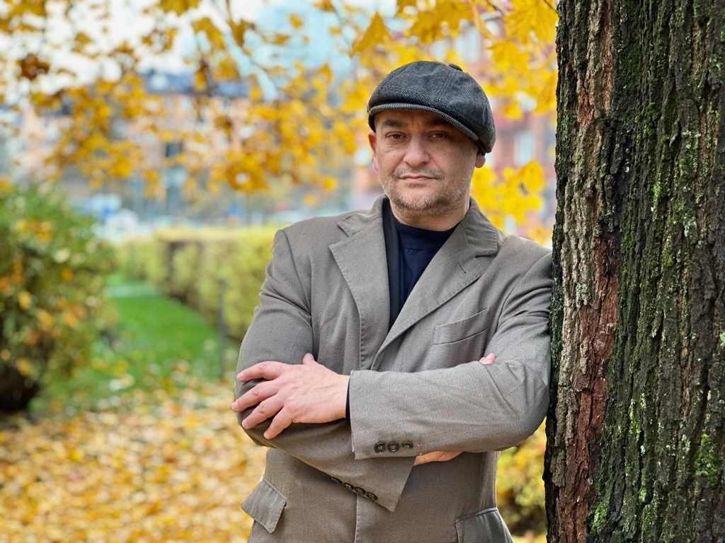
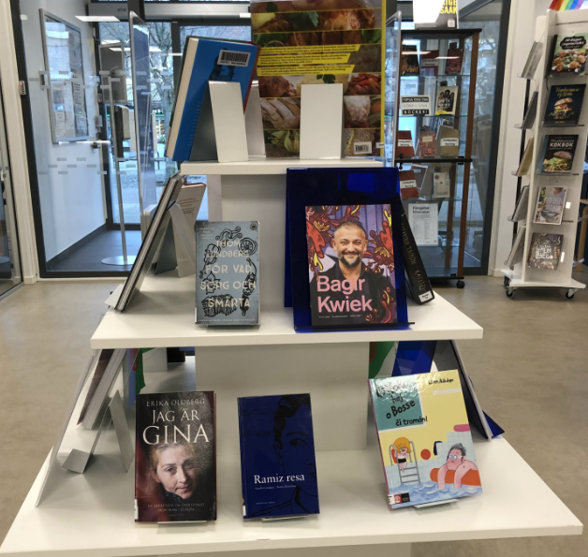
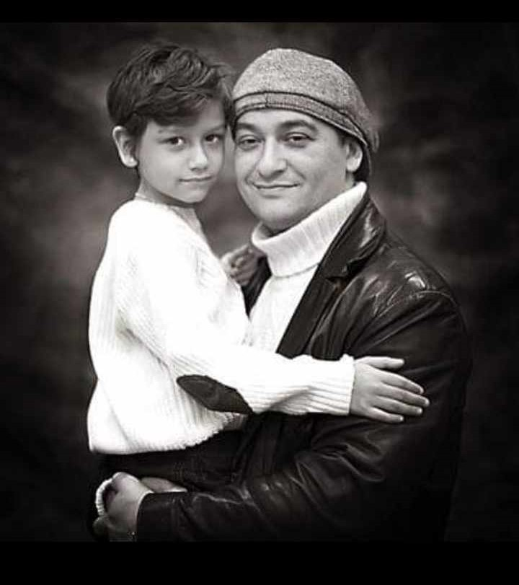
Roma Reading Ambassador Bagir Kwiek
Photo: Bagir Kwiek (private)

Slide 35
Step 5: Create participation
Jointly create the next steps.
Participation is important but also difficult—planning for the right level of participation is a key factor.
There are many forms of participation and consultation:
Micro in daily operations
Informal meetings, UX, user design, etc.
Formal consultations
What are our respective roles?
What does the power balance look like? Who is privileged? Who has the final say?
Participation requires time and resources and a willingness to work together.

Slide 36
Step 5: Exploratory approach
Try different methods, discuss together what possibilities exist and what works locally.
Embrace a gradual joint development, where participation increases on Roma terms within clear frameworks.
Don’t create expectations that cannot be fulfiled!
Take small steps and think long-term.
The foundation for a good dialogue is based on:
Expectations
Communication and clarity in dialogue
Frameworks for partnerships
Photo: Gävleborgs Roma Internationella förening

Slide 37
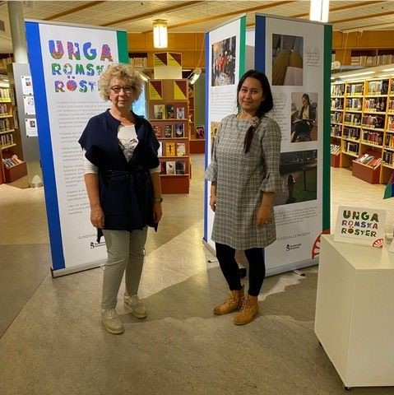
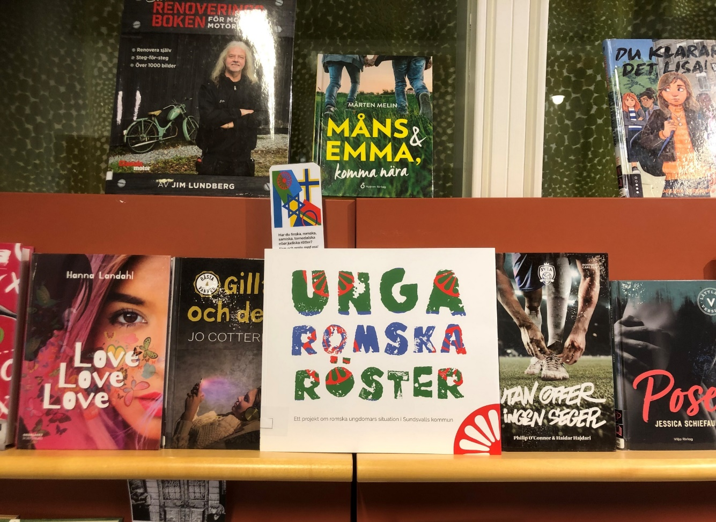
Sundsvall: Young Romani voices
15 young Roma have participated in a project to give voice to everyday Romani life.
Important questions raised by the project are how the young people themselves describe their situation and what problems can be discerned based on their experiences of school, work and leisure.
Photo: Sundsvall Public Library
Photo: Elisabet Rundqvist KB, Sundsvall Public Library

Slide 38
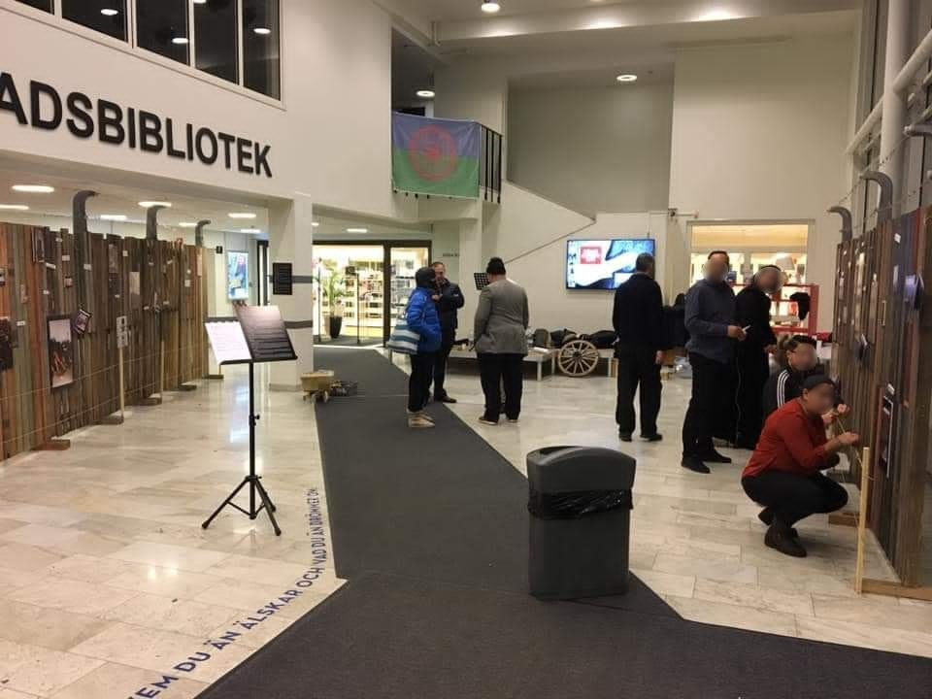
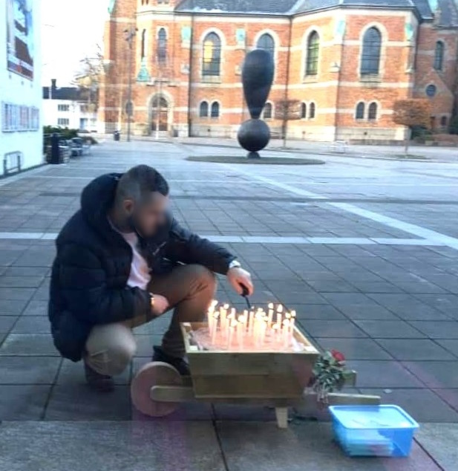
The Roma’s Block 13 exhibition in the Culture House in Borås
This exhibition was created to show a Roma group's thoughts about and reactions to their visit to Block 13, the Roma barracks in Auschwitz.
The Roma themselves created the exhibition, even creating the fence posts to resemble those in Auschwitz.
The exhibition toured local libraries in the Swedish municipality.
“I was with them there as a representative of the libraries.” Åsa-Maria Berg Levinsson, Borås Public Library
A wheelbarrow with sand, symbolising the wheelbarrows with ashes of those killed in Birkenau. Lighting candles to remember those who lost their lives.
Notes:
The picture also shows a small piece of writing that they printed "It could have been my family" where they have written about how they experienced the visit to Auschwitz. It has been available for reading and lending at the Borås city library and also accompanied the exhibition when it toured.

Slide 39
Discuss
…
Accessibility
Access to... in accordance with the users’ needs and abilities.
Participation
Is it possible to simply join in, to be on equal footing?
Inclusion
Power relations? Rights?
Partnership
Agreements about collaboration?
Photo: KB

Slide 40
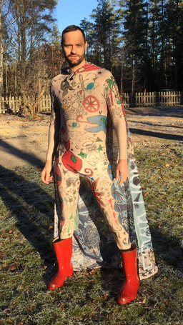
Problematising norms and their limitations
Lindy Larsson in a costume from the performance Roma Armee at Maxim Gorki Theater, Berlin.
Focus on critiquing the norms and the limitations they impose, rather than problematising what deviates from the norm.
Consider how norms and power are interconnected. Where do these norms originate?
Identify the existing norms: patriarchal norms, norms of masculinity, LGBTIQ+ norms, norms around people of color (POC), age, etc.
Test these norms against Romani values. Do you get the same results?
Whose perspectives and experiences are centred?
How can we challenge stereotypes?
Summon the courage and resilience to be the one who questions these norms!
https://www.araart.cz/en/roma-lgbt/pribehy
Stefan Forss, CC BY-SA 4.0 <https://creativecommons.org/licenses/by-sa/4.0>, via Wikimedia Commons

Slide 41
Culturally sensitive dialogue
…
Culturally sensitive dialogue requires some reflection on or knowledge about:
Perceptions of time
Expectations - when will this happen?
Time of day for scheduled activities or dialogues
Traditions, perception of life, and sometimes of death/mourning (according to tradition and religious beliefs)
Range of emotions and how they are expressed
Taboos or topics you don't talk about without having built trust and context within the group
Strong emotions due to prolonged oppression might surprise you.
Disagreements …

Slide 42
Empowerment
Library
Learning
Needs
Planning
Building trust
Safe place
Representation
Photo: Gävleborgs Roma Internationella förening

Slide 43
https://www.socialworkerstoolbox.com/feelings-cards-naming-feelings/

