Slide 1
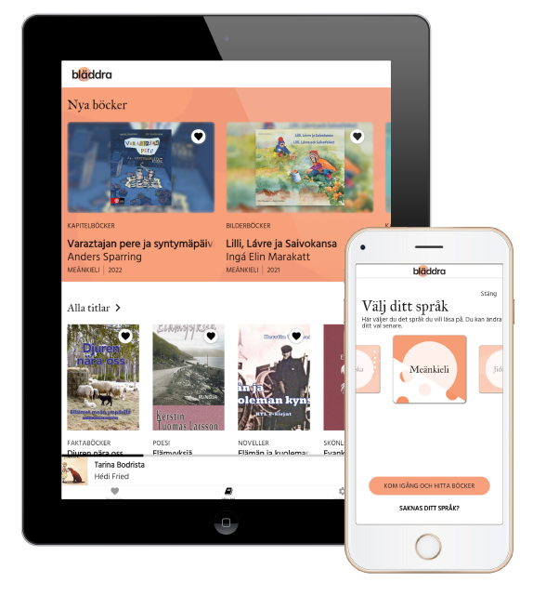
– Free access to e-books in Swedish national minority languages
Elisabet Rundqvist National Library of Sweden

Slide 2
”... the public library
system shall devote
particular attention to
national minorities”
Notes:
The Swedish Library Act:
“Libraries in the public library system shall devote particular attention to national minority groups. In the Library Act, there is no comprehensive listing of the various ways in which activities should be adapted for these groups. It is stated, however, that this has to do with supplying literature in the national minority languages, i.e., in Finnish, Yiddish, Meänkieli, Romani, and Sami.”
However, there’s not many published titles in the national minority languages
So naturally there are not a lot of titles available through the libraries
The access to literature in the national minority languages varies a lot in the different parts of Sweden.
https://www.biblioteksforeningen.se/rapporter/promoting-the-development-of-a-democratic-society/

Slide 3
Analysis of the book market and library collections (2018)

Slide 4
Available literature
Yiddish Limited book publishing
Finnish Wide range of books
Meänkieli
Limited book publishing
Romani Limited book publishing
Sámi Limited book publishing
Notes:
Sweden have five official national minority languages: Yiddish, Finnish, Romani, Meänkieli and Sami. Romani, Meänkieli and Sami have several dialects or varieties.
There are several laws protecting their rights. The most important ones are The Language Act (2009:600) and The Act (2009:724) on National Minorities and Minority Languages.

Slide 5
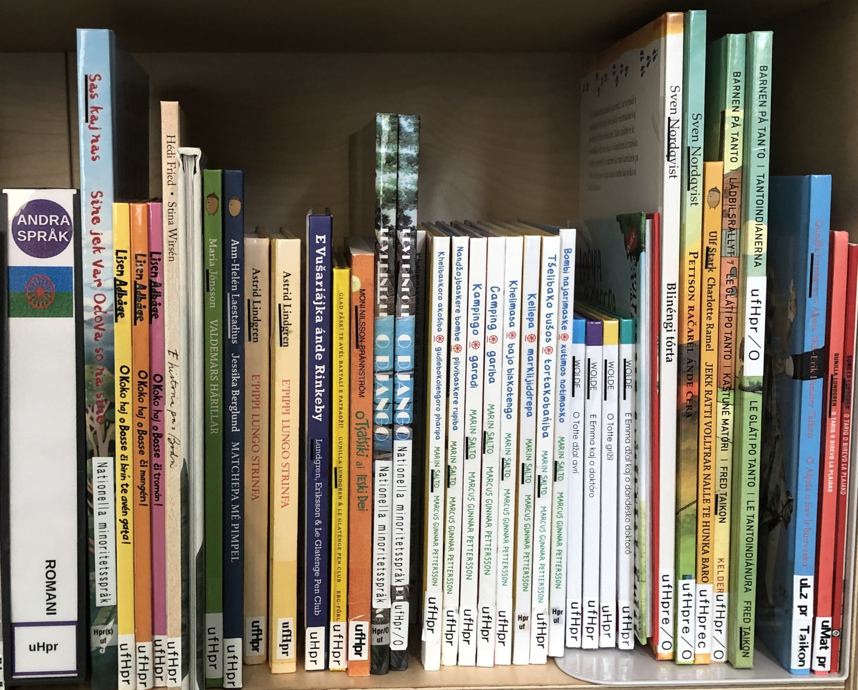
Low priority in public libraries.
Limited competence in content acquisition, usually from small publishers outside of typical procurement methods.
Limited print runs, hard to obtain once sold out.
Library holdings in the public libraries are unevenly distributed across the country.

Slide 6
Bläddra aims to be
part of the solution

Slide 7
A pilot project in two parts
Investigating content Cooperation with minorities and copyright holders
App development
Notes:
Uppdrag Apputveckling
Ta fram koncept och design för prototyp, baserat på användarnas behov
Tvärfunktionellt team med designers, utvecklare och metadata-expert.
Beställare gentemot sakkunniga inom språkgrupperna, för kvalitetskontroll av språkanvändning, symboler och design.
Utveckla tjänsten
Bygga upp utvecklingskompetens av appar internt.
Utreda tekniska aspekter kring appen, såsom vilken e-boksläsare som ska användas och förslag på hur publiceringsflöden för e-pubfilerna kan se ut.
Bygga appen för senare distribution via Google Play och App store.
Verifiera tjänstens relevans och nytta med slutanvändare och företrädare.
Uppdrag Innehållsutredning
Kartlägga material på minoritetsspråken
Inventera befintliga innehållsresurser att distribuera via appen.
Tillsammans med representanter från språkgrupperna utreda vilket material som bör ingå i tjänsten.
Utreda möjliga samarbeten
Kontaktperson gentemot företrädare för språkgrupperna, för förankring och samverkan rörande innehållet i appen.
Undersöka möjlig samverkan med Kulturrådet och andra myndigheter/verksamheter med överlappande uppdrag kring minoritetsspråk.
Utreda möjliga affärsmodeller
Utreda och ta fram affärsmodeller för att köpa loss rättigheter, inkl. avtalskonstruktioner, licensformer, rättighetsfrågor etc i samråd med jurist.

Slide 8
The 2019–2021 project development team
Adviser, national minorities
Product manager
Project manager
UX-designer (investigated user needs) IT developers Librarians – bibliographical work and language coding Licence negotiator
Graphic designer
Reference group with national minorities
Notes:
Lovisa
The pilot project to create Bläddra started in spring 2019. The objective was to investigate what this national digital library service for literature and reading could be and create a viable but limited product with a limited number of languages to start – an Ebook Reader Application that
gives equal access to books in two national minority languages in all of Sweden
is a usable tool for reading promotion in libraries

Slide 9
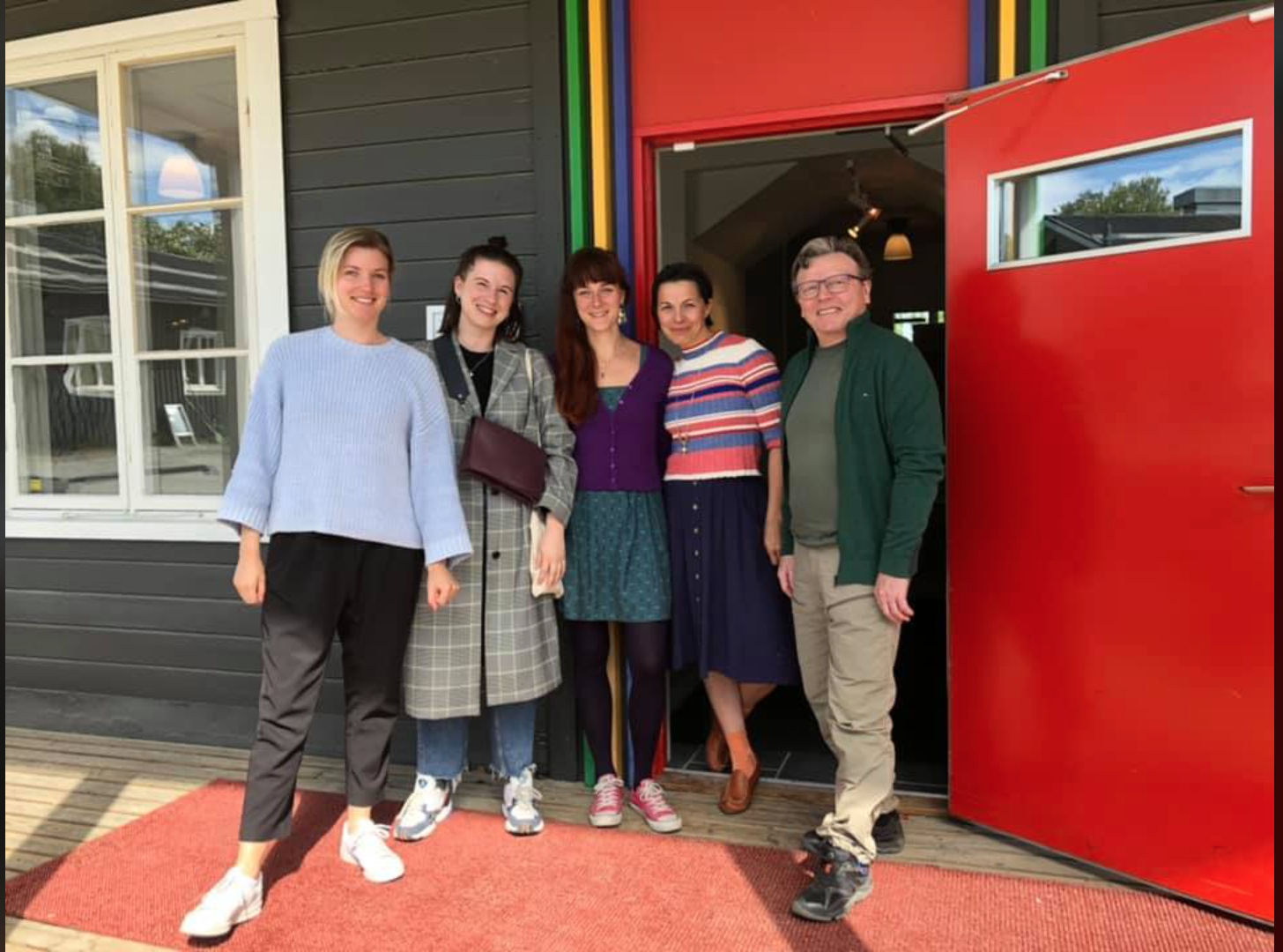
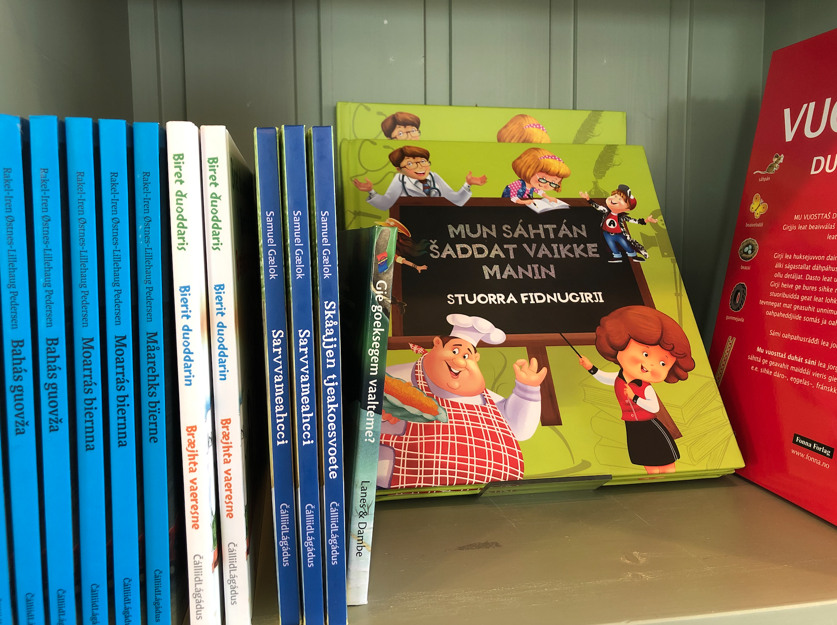
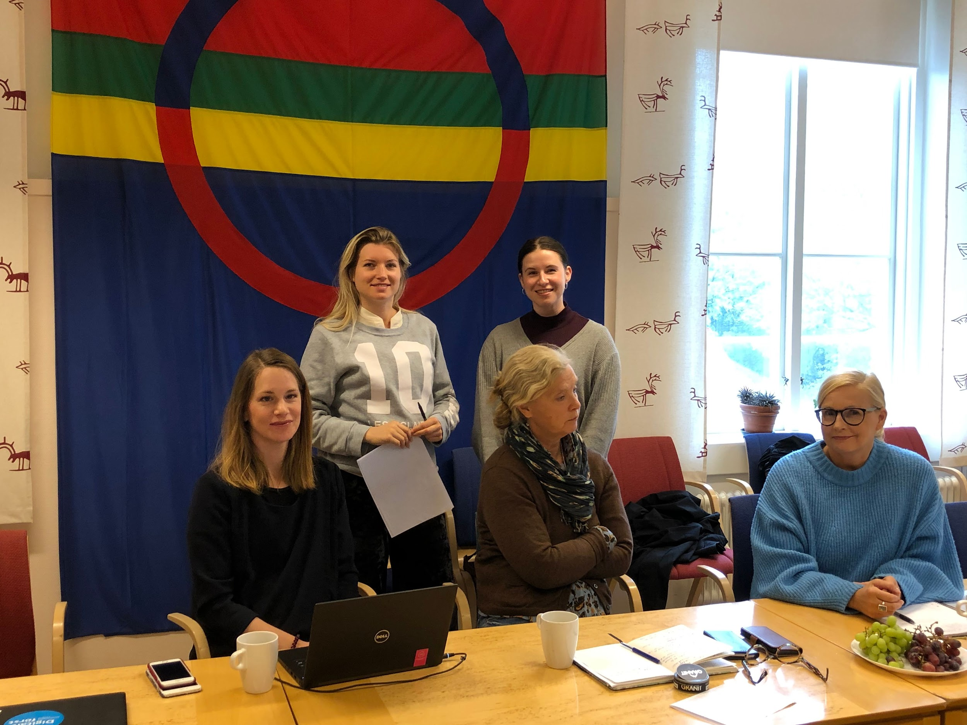
...
MEETINGS AND DIALOGUE
...
UX and user needs
Notes:
A cornerstone to succeed with the project is the focus on dialogue and cooperation with representatives for the national minority languages, potential users, librarians, native language teachers, authors and publishers.
UX-designers and project managers for app development and content visited Jokkmokk, Östersund, Gbg, Helsingborg/Malmö to listen and learn.
Formed a reference group - national minority libraries, relevant government agencies such as the Swedish Arts Council and the regional library of Norrbotten.
(UX=user experience)

Slide 10
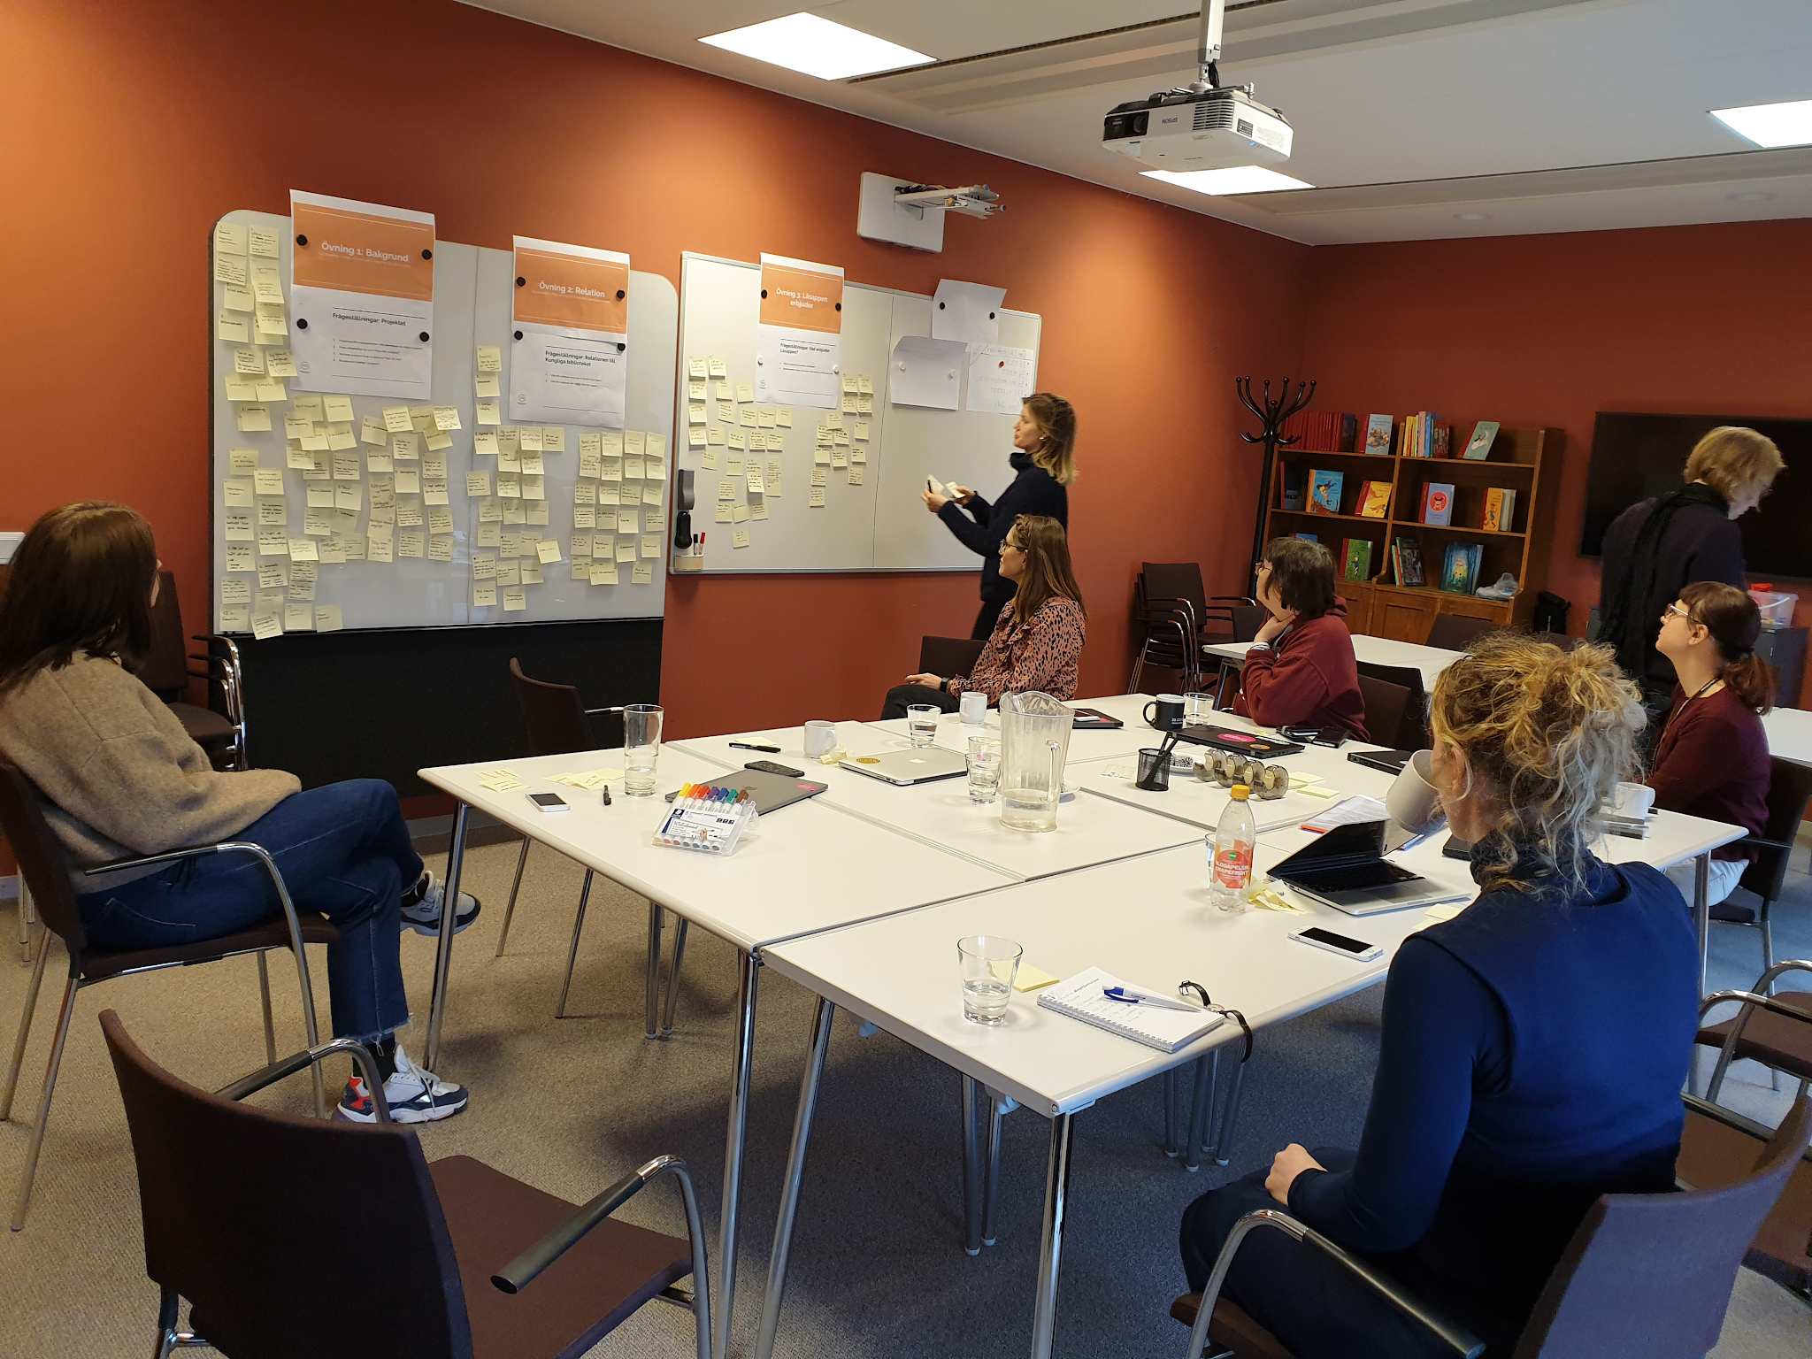
Design principles
Equality
Just like other reading services
Doesn’t single out national minorities
Read wherever you want
Anonymous usage
Free literature without conditions
For all ages
This is just for you
The app's focus is reading
Trustworthy
Credible Stable
Reliable
Curated content Privacy-preserving Serious and useful At the forefront Past, present, future Classic and modern

Slide 11
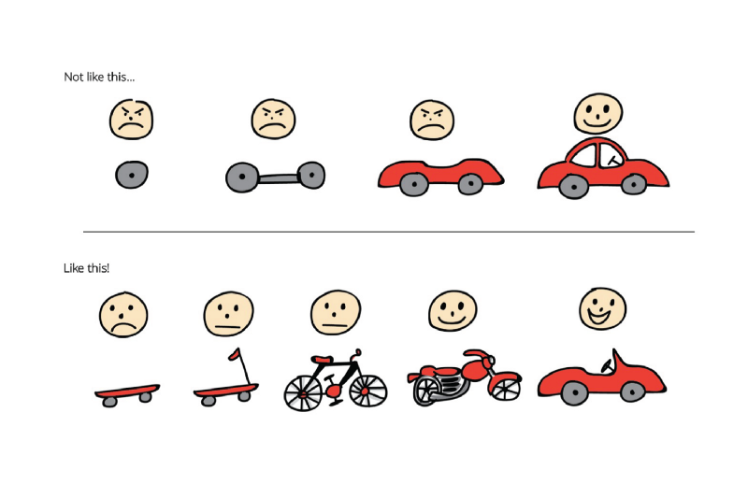
MinimalViable Product
Notes:
MVP
Dvs hitta de funktioner som gör att appen initialt får tillräckligt mycket värde för att användare ska vilja använda den.
Så när pilotprojektet är över hoppas vi vara här runt sparkcykeln. Något som går att använda, som har de viktigaste funktionerna och uppfyller de viktigaste användningsmålen. Men som självklart kan vidareutvecklas och bli bättre.

Slide 12
“The Leisure Reader”
No registration, no user account! No library card!
“An e-book service in my language”
Wants a mix of titles for all interests. Fiction and non-fiction.
Wants a modern and relevant reading app.
Low thresholds!
Jumping directly into the book
Offline reading!
Unlimited number of downloads
Notes:
With regard to the needs and wishes from potential users and the limits of the project we decided on a group we called “the leisure readers” as our main target group for Bläddra. This is a group with a lot to gain by just getting easy access to books in their own language.
Readers learning to read in the languages need a lot of extra features such as a dictionary function and being able to listen and read at the same time.
And while librarians and teachers might be important as intermediaries, the content is structured for the actual reader.
Bläddra is an app with a focus on reading promotion, not language revitalisation. Of course you can use it for language revitalizing purposes but it’s not the main focus.

Slide 13
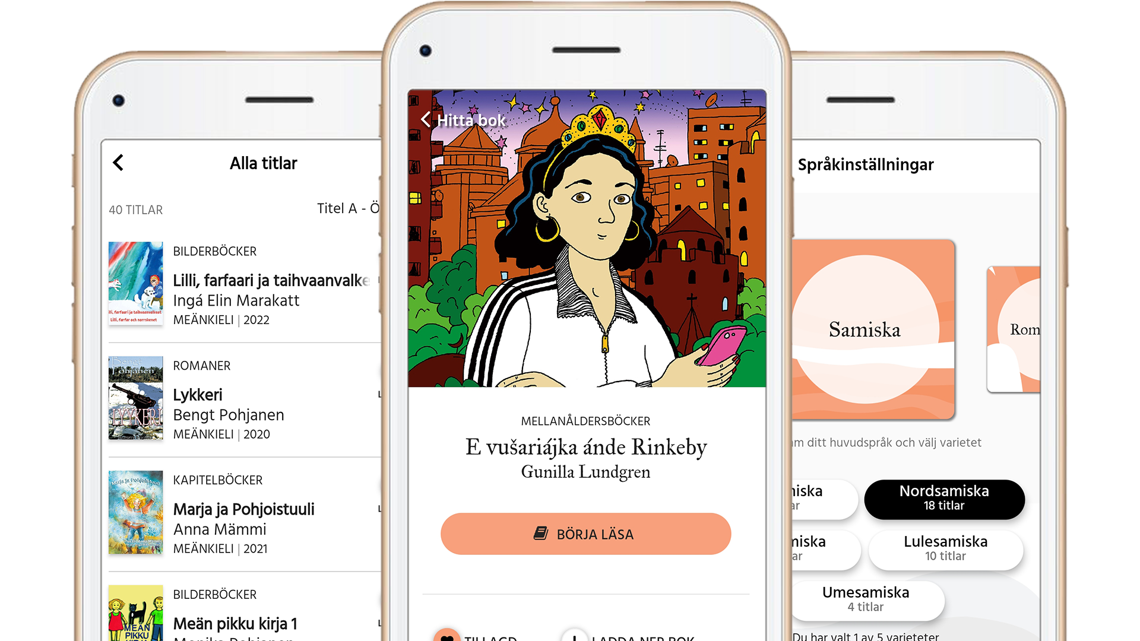
Shapes and colours
Logo
App icon
Notes:
Anja
Ett utforskande iterativt arbete där vi m.h.a. två konsulter från HiQ tagit fram olika koncept för potentiell logga. Dessa förslag har vi visat upp och diskuterat tillsammans med projektgruppen för att snäva ner de olika förslagen mer och mer och förfina de vi gått vidare med.
Till slut hade vi två inriktningar var där projektgruppen nu röstat fram en “finalist”. Och där är vi nu och såhär ser den ut i just nu. Har “fulklippt” in den i olika appkontexter för att se den i kontext. Vägen fram nu är att finputsa logotypen tillsamman med konsulterna och få den levererad i de olika formaten vi beställt. Dvs Appikon och logotyp i olika versioner som vi kan använda i olika sammanhang.
Några argument varför vi valt denna: Vi kallar den “Den abstrakta” Bygger på känsla och öppen för tolkning, inbjudande och lite sagolik. Modern och fungerar bra tillsammans med appnamnet Bläddra, som är ett krasst och tydligt namn. Formen och tonaliteten känns även igen inuti appen. Namnet och logotypen sticker ut i jämförelse med andra bok e-bokstjänster men är inte utpekande för nat.min, vilket var viktigt när vi tog fram dom.

Slide 14
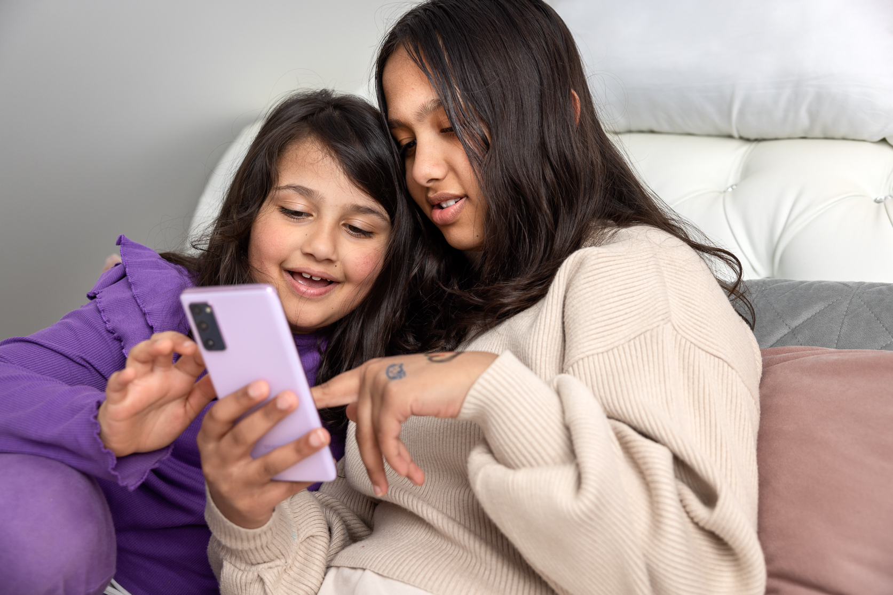
Launch in April 2021
Notes:
The launch received quite a lot of attention in social media
Almost 1000 people have the Bläddra app downloaded today
There has been a little more than 1500 loans since the start
We are happy to see that quite a few libraries have added Bläddra to the list of digital services offered on their web site

Slide 15
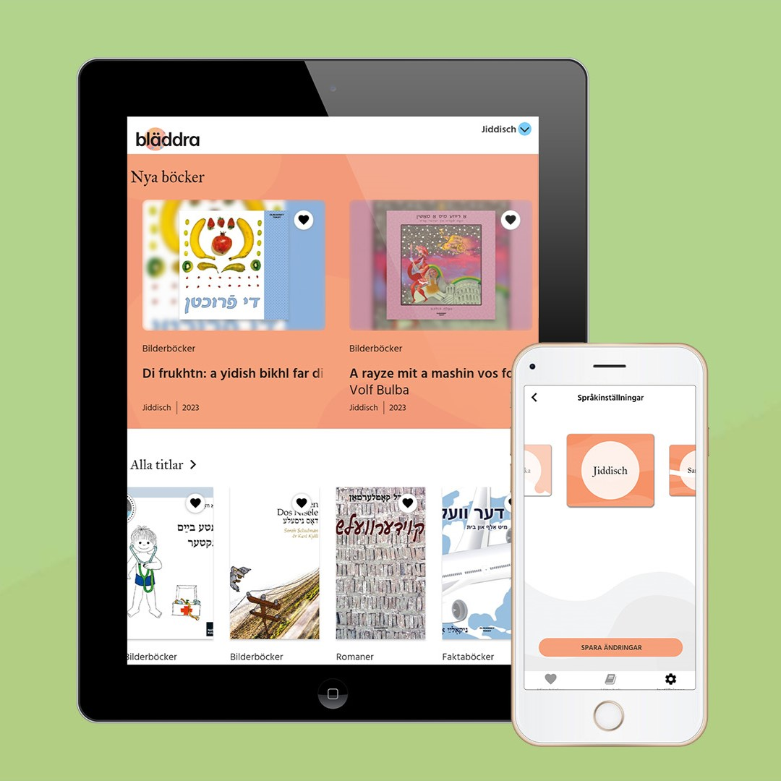
Bläddra
A free app with literature in all minority languages, except for Finnish
Launched in 2021 with two languages, Sámi and Romani
Meänkieli added in 2022 and Yiddish in 2023
The interface is designed for adults and young adults, but the app offers a large selection of children’s literature.
Audio player is the next step…
Notes:
The launch received quite a lot of attention in social media
Almost 1000 people have the Bläddra app downloaded today
There has been a little more than 1500 loans since the start
We are happy to see that quite a few libraries have added Bläddra to the list of digital services offered on their web site

Slide 16
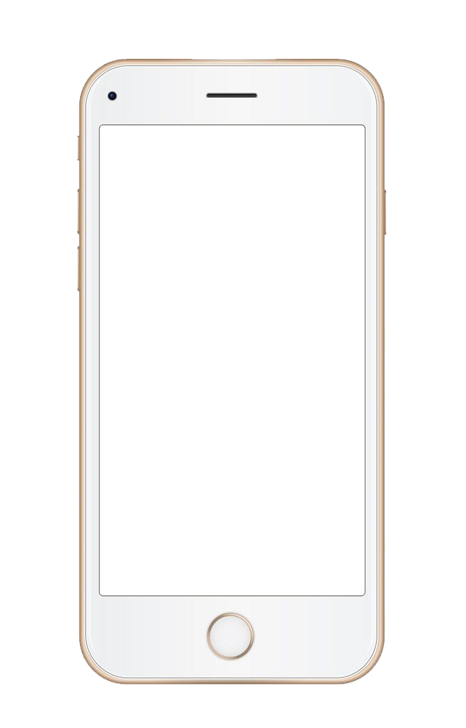
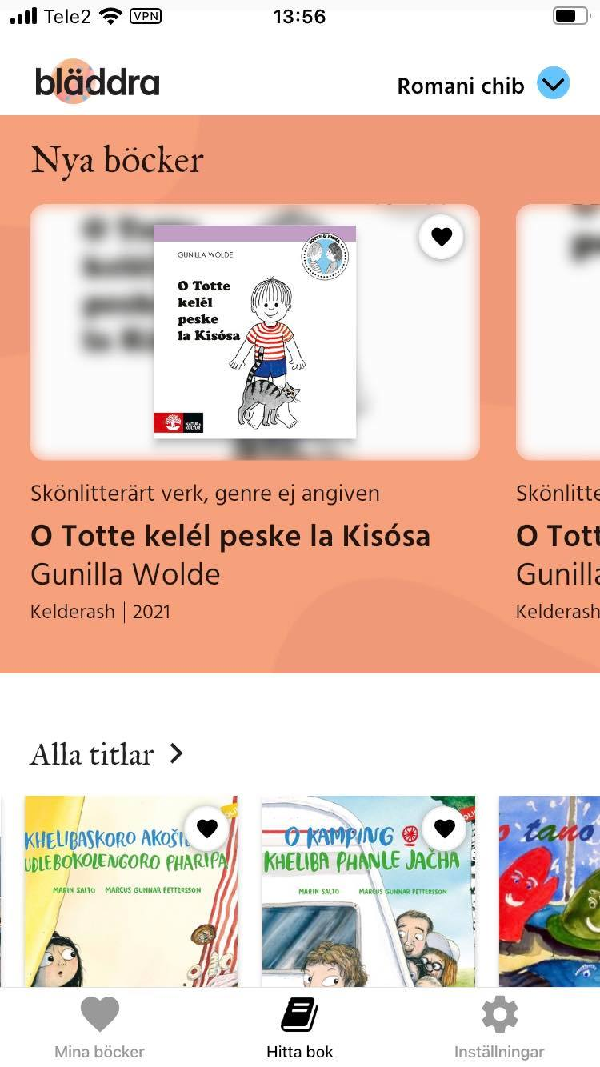
Bläddra
The app interface language is Swedish
The integrity of the user is a high priority
No user account or connection to library card
E-books are downloaded, not streamed
Offline reading for downloaded books
Only available in Sweden!
Licencing costs and ongoing development costs total approx. € 176,650 annually

Slide 17
Technical information

Slide 18
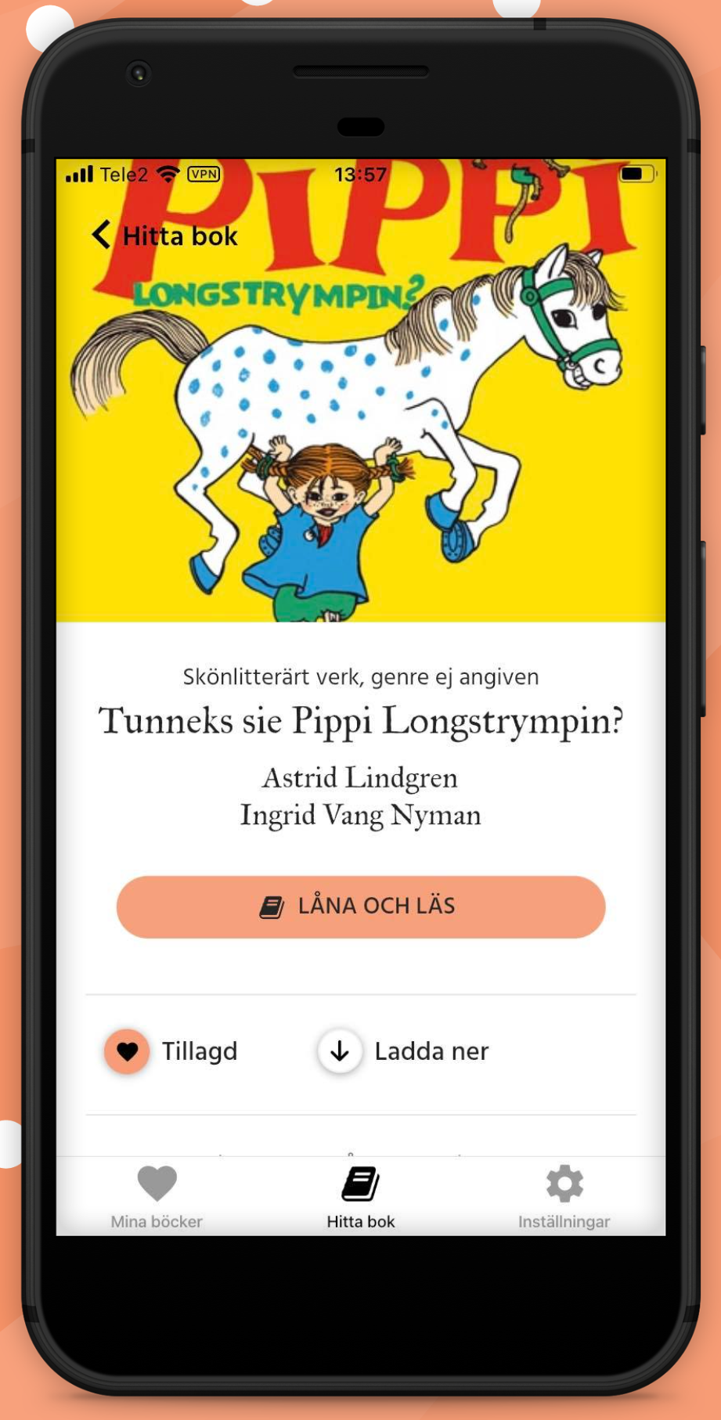
Open source framework for app building
In house adaptations and development
.
Upgrade in IOS
Fix bugs
Add features
Add languages
Open source e-book reader
Bläddra is dependent on upgrades and new features in Readium.

Slide 19
Content

Slide 20
Media policy
The media policy was drafted in collaboration with the project's reference group.
Strategic basis for literature and media work
Connects the purpose of the app to the content
Clarifies target groups and needs
Highlights primary governing documents
Provides guidelines and boundaries for selection and purchasing
Describes role collaboration in literature selection
Notes:
, e.g., user perspective and inclusion

Slide 21
Detective work
State-funded support to publishers to create digital versions of print books
Identify books published in minority languages, compile lists of titles with publisher information – Long list
Long list ranked by minority representatives
Clarify copyright holders for top-ranked titles – Short list
Dialogue with copyright holders about converting print books to e-books
Negotiate licence agreements
Produce EPUB files

Slide 22
Content in Bläddra August 2024: 191 titles
ROMANI CHIB
SAMI
49 titles
118 titles
ARLI
PITE- SAMI
LOVARI
YIDDISH
MEÄNKIELI
SOUTH SAMI
KALE
LULE- SAMI
5
7
4
54
UME- SAMI
32 titles
61 titles
KELDERASH
5
SWEDISH ROMANI
NORD- SAMI
20
6
26
31
9
Notes:
Bläddra innehåller e-böcker på de nationella minoritetsspråken meänkieli, romani chib, samiska och jiddisch. Sammanlagt 181 titlar på språken och deras varieteter.

Slide 23
Downloads through August 26 2024
Kelderash – 317
Swedish Romani – 410
Kale – 72
Lovari – 158
Arli 153
South Sami – 766
North Sami – 1425
Lule Sami – 794
Pite Sami – 73
Ume Sami 147
Meänkieli (2022) – 1449
Jiddisch (2023) – 333
Total: 6 097 downloads
1 110
3 205

Slide 24
Promotional materials

Slide 25
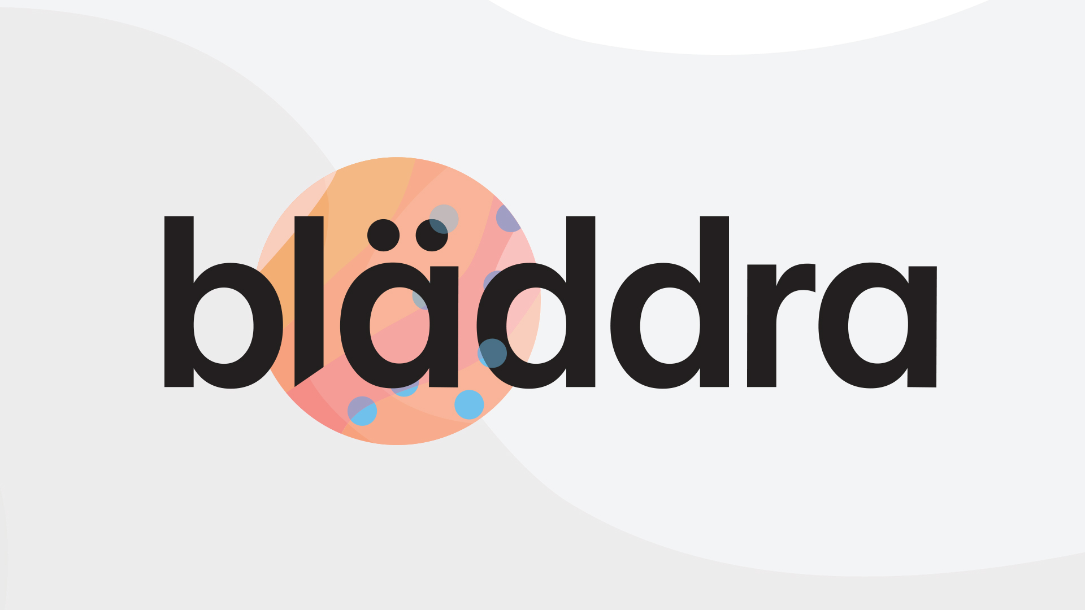
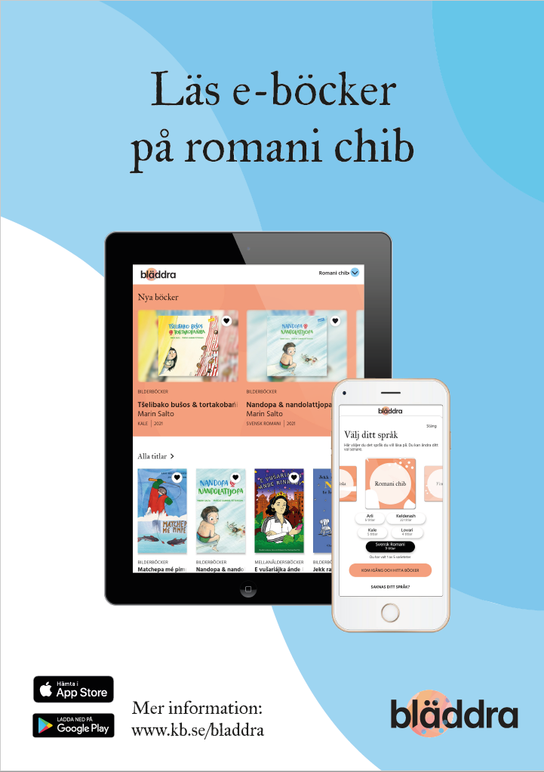
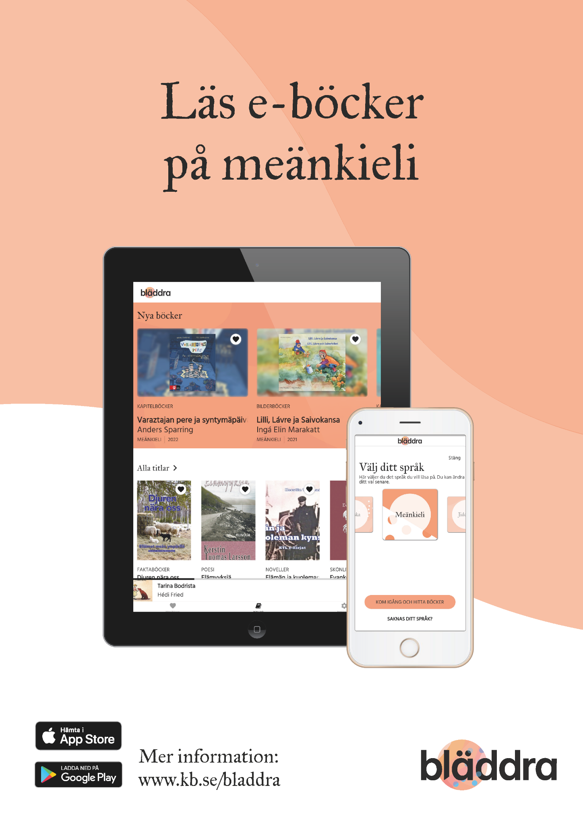
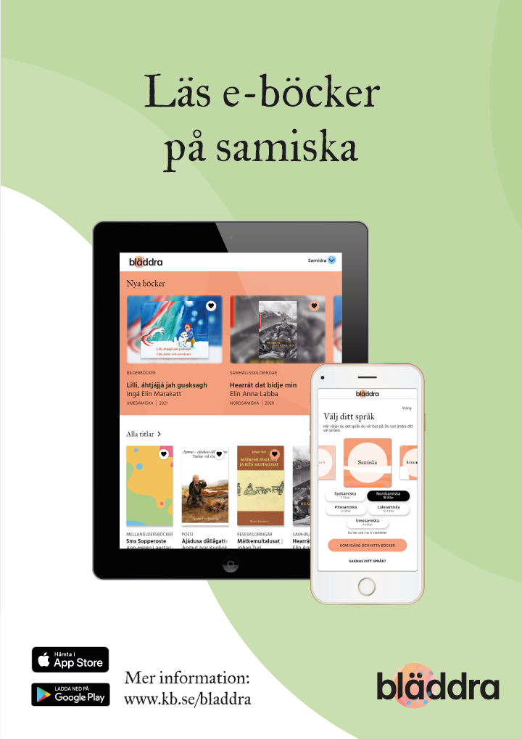
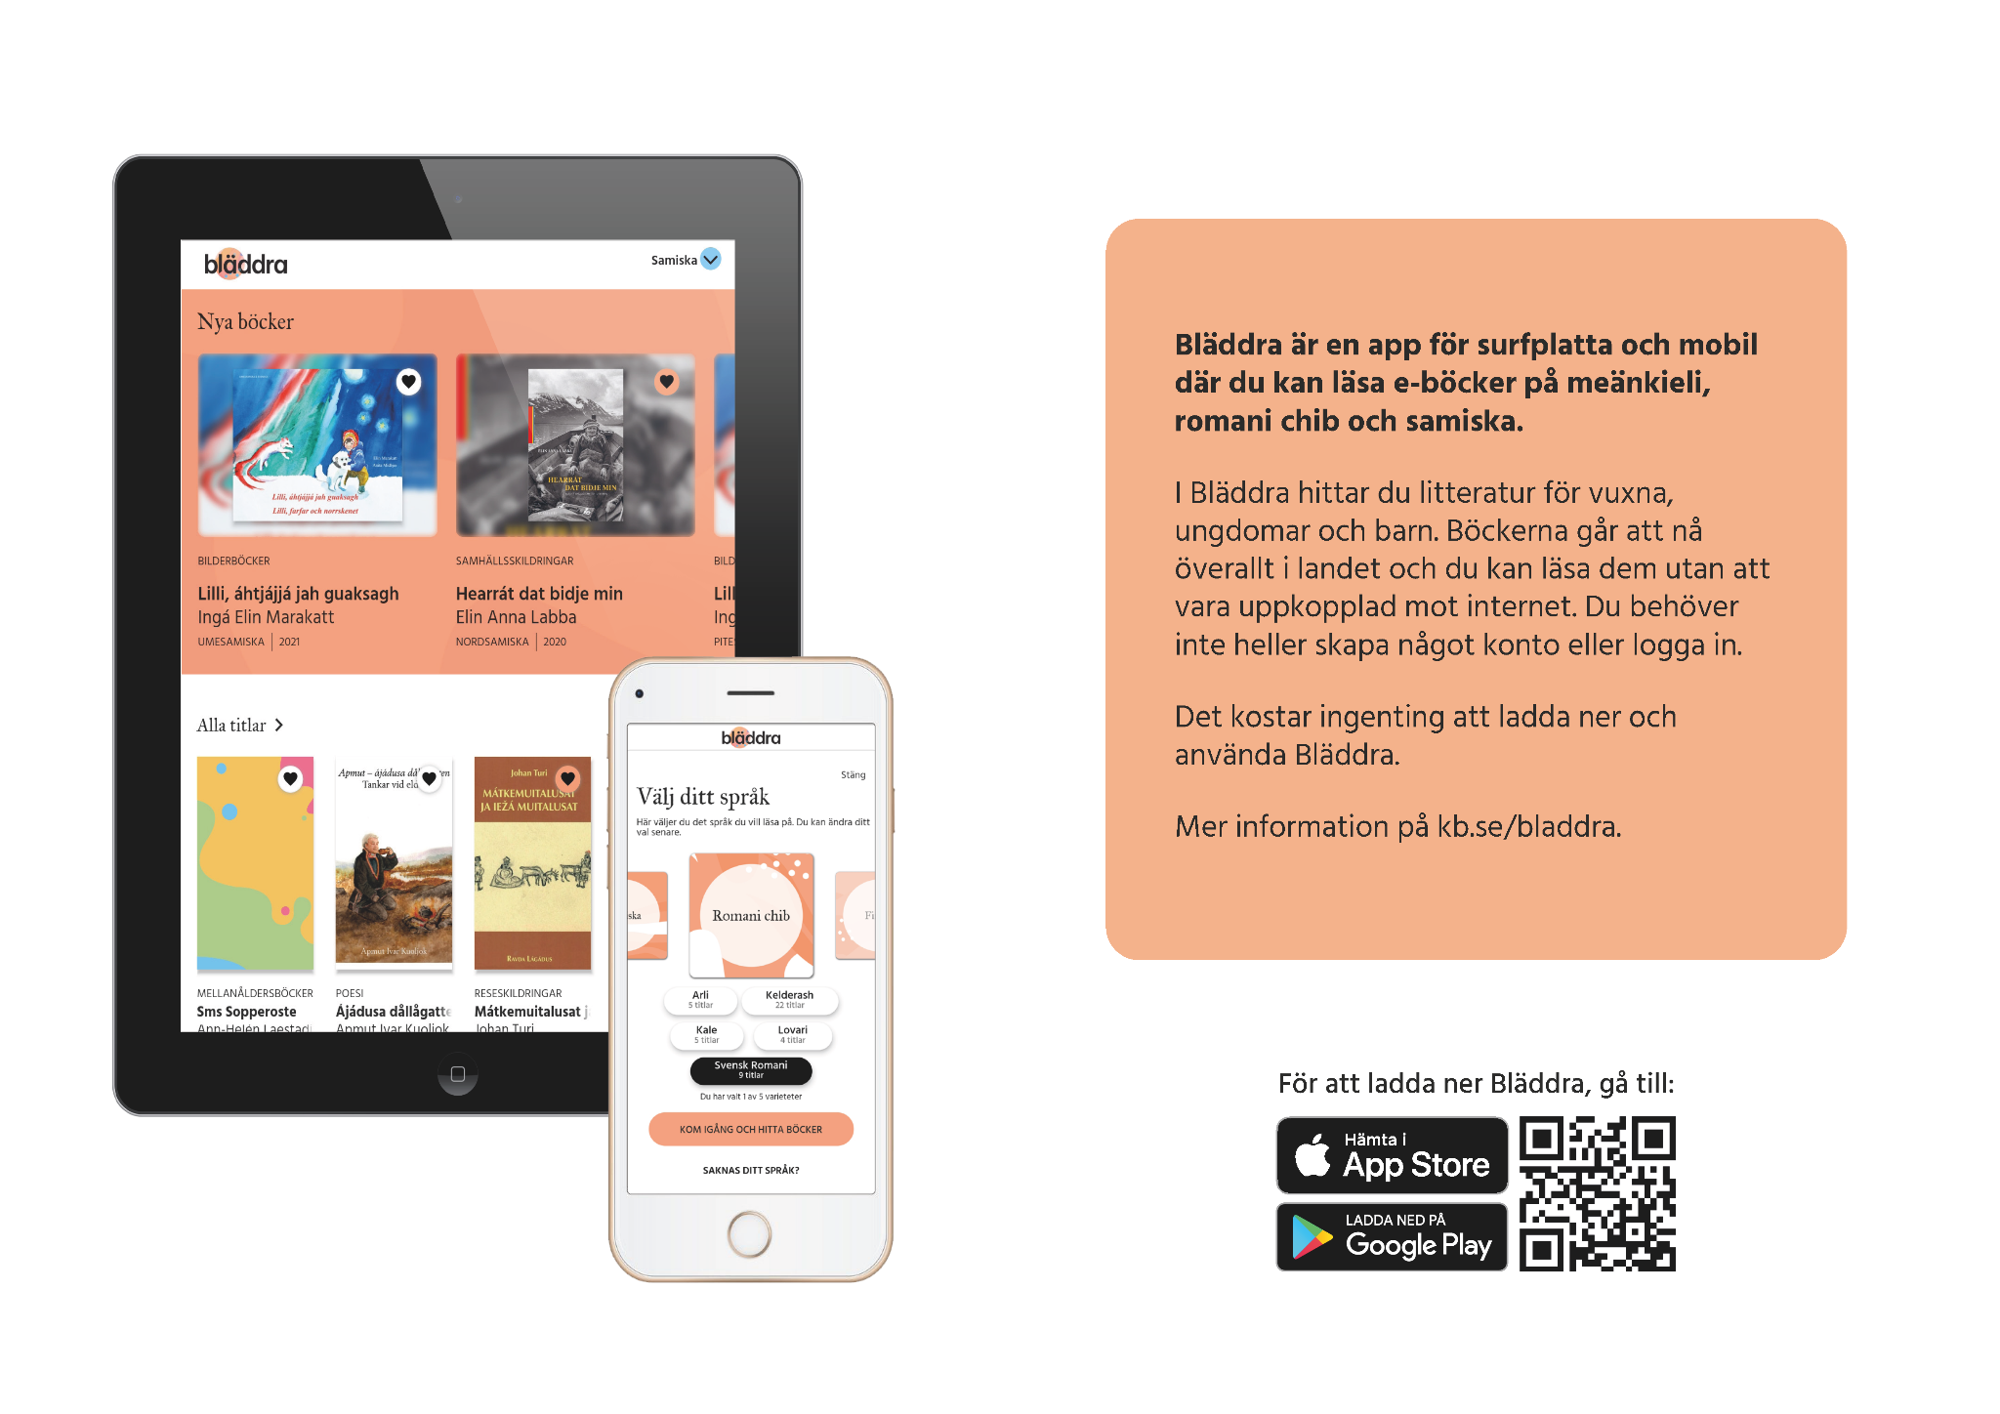
Posters
Folders
Web ads
Logo
App screenshots
Animated instruction video

Slide 26
Thank you!
More info
www.kb.se/bladdra (in Swedish)
elisabet.rundqvist@kb.se technical info Anja.Bergman@kb.se
Notes:
Lovisa

