Slide 1
E-lending in Europe // Mikkel Christoffersen, EBLIDA director Maribor, Wednesday September 18th 2024

Slide 2
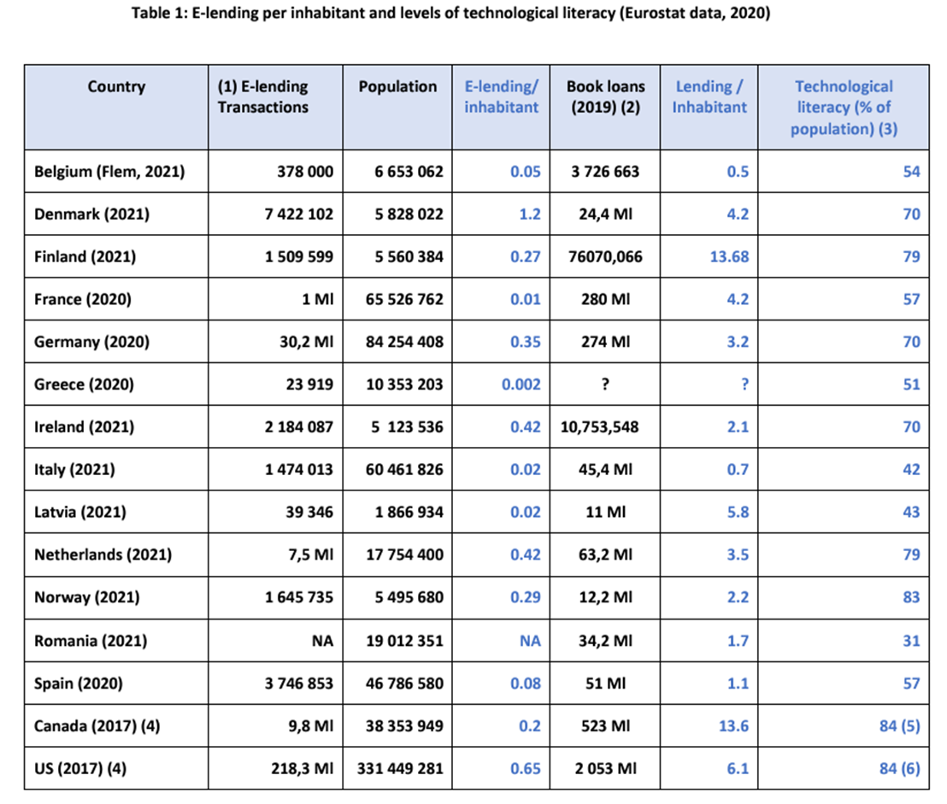

Slide 3
E-lending issues
Question 1: Procurement issues: Rising demand from users, increasing costs of eBook licenses, restrictive licensing terms, and restrictions on availability of content
Question 2a: Short-term provision issues: The immediate impact of e- on services, library space and the professions
Question 2b: Long-term provision issues: The transformation to the library mission caused by the switch to provision of digital information
Everybody has both type 1 and type 2 problems, though for many type 1 dominates
“Solving” type 1 issues typically lead to more severe type 2 problems
No one is ever safe from going back to type 1 problems
The spectacular heterogeneity of e-lending solutions – especially the English-speaking world vs. the rest

Slide 4
Two tragedies in life
One is not getting what you want. The other is getting it*
One tragedy of e-lending is not getting any books. The other is getting all the books … especially the audiobooks!**
* Oscar Wilde, Irish playwright (1854-1900)
** Me

Slide 5
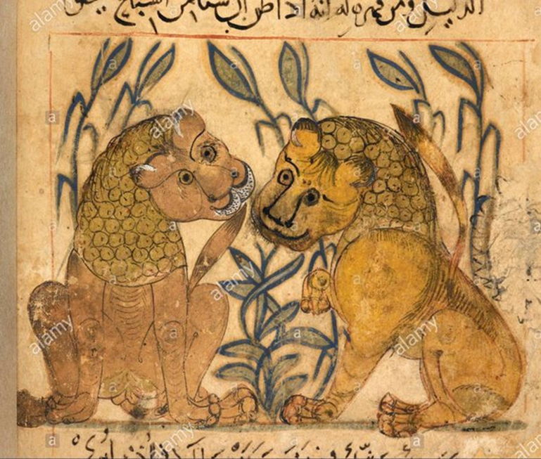
The parable of the lion cub
Once a romping tumbling toy in a deep-plush coat of gold
was a father's children's playtime joy, chuckled at by the old:
a hunter had brought home with him a lion-cub for a pet,
mewing suckling cub that mumbled him with toothless gums as yet,
eyes sharp on his hands when he cradled it for whatever it could get.
Time went on; the lion-cub grew; shy before, it turns to bold;
talon-claws, teeth needle-new, watch the nature in it unfold;
what the hunter had brought home with him lets its parent instinct
out, pays the old hosts who had smiled at it in bloody cattle-rout:
across the marble floors of the nursery red sacrifices spout.
Aischylos: Agamemnon, 458 BC

Slide 6
The first rules of digital libraries in Europe
Our physical libraries look a lot alike, but our digital libraries look nothing alike!

Slide 7
Why is this bad?

Slide 8
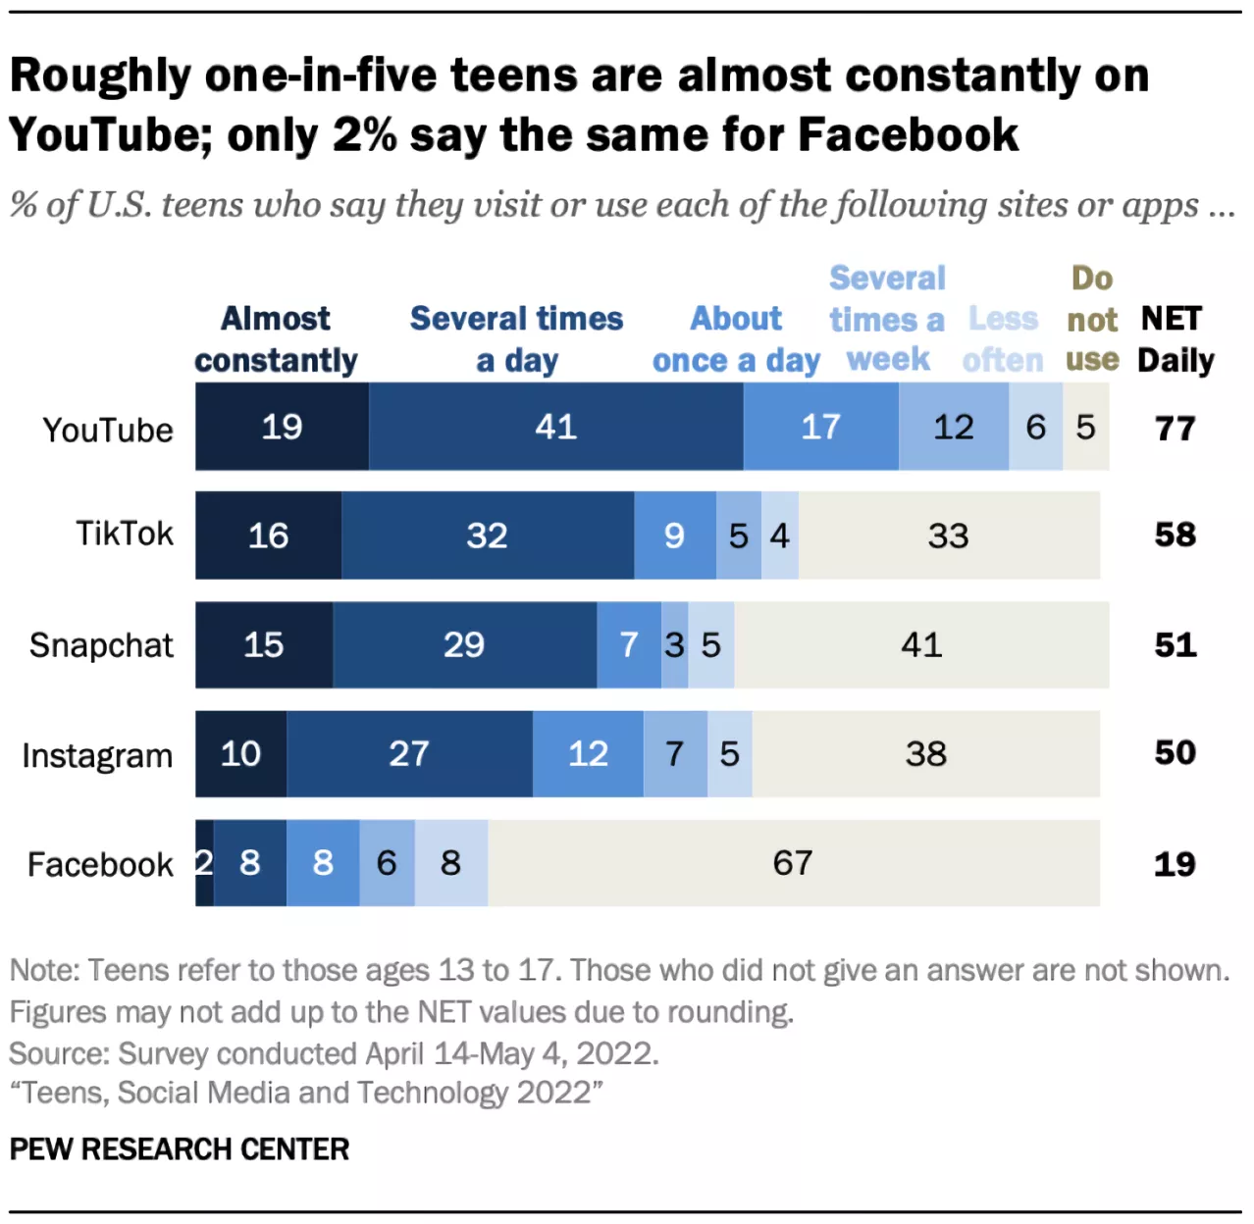

Slide 9
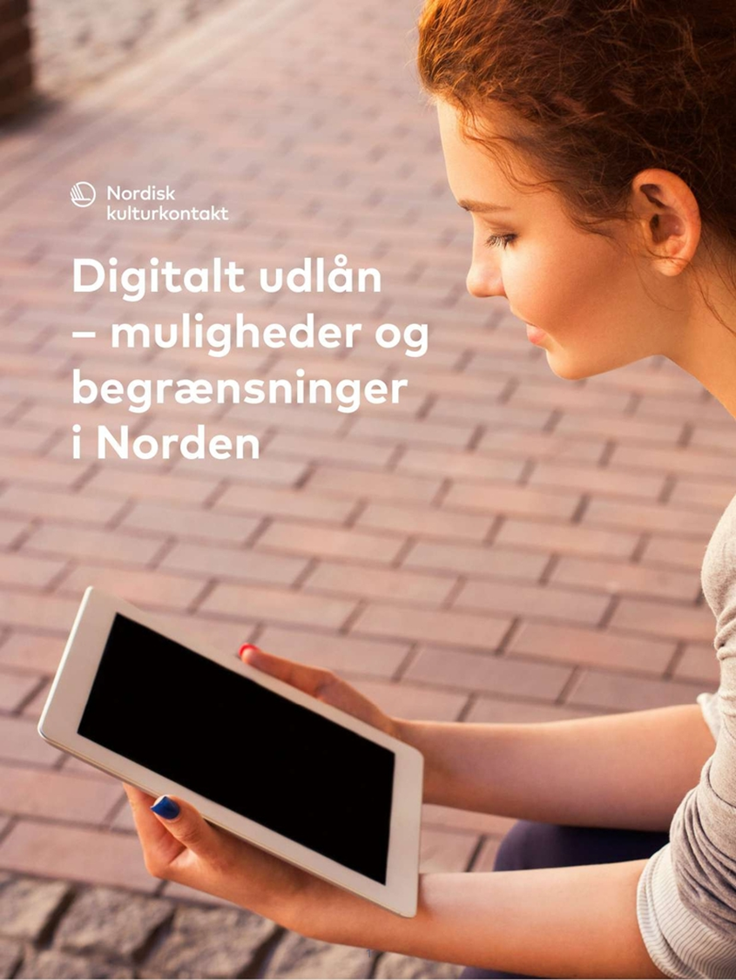
Building an e-lending service
Report for the Nordic Council
Can we make a Nordic e-lending service?
Short answer: No
Long answer: Also no, but with a whole report!
Payment models and border issues

Slide 10
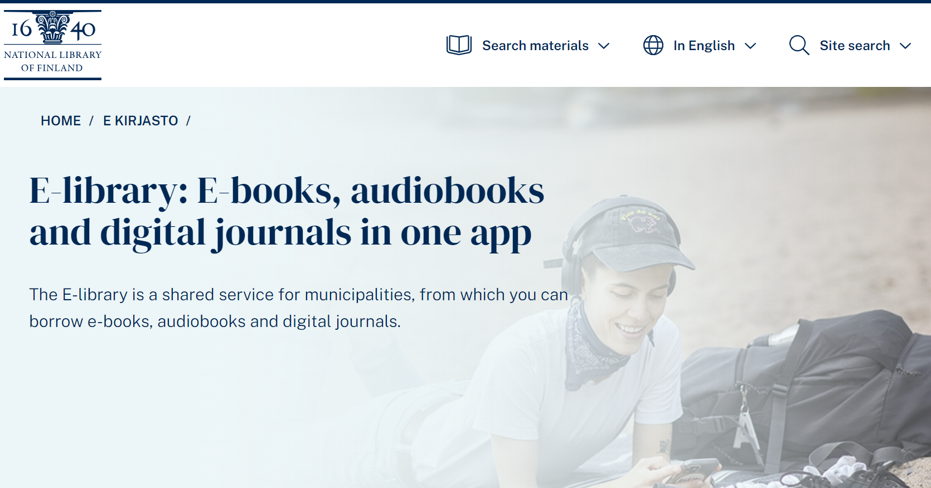
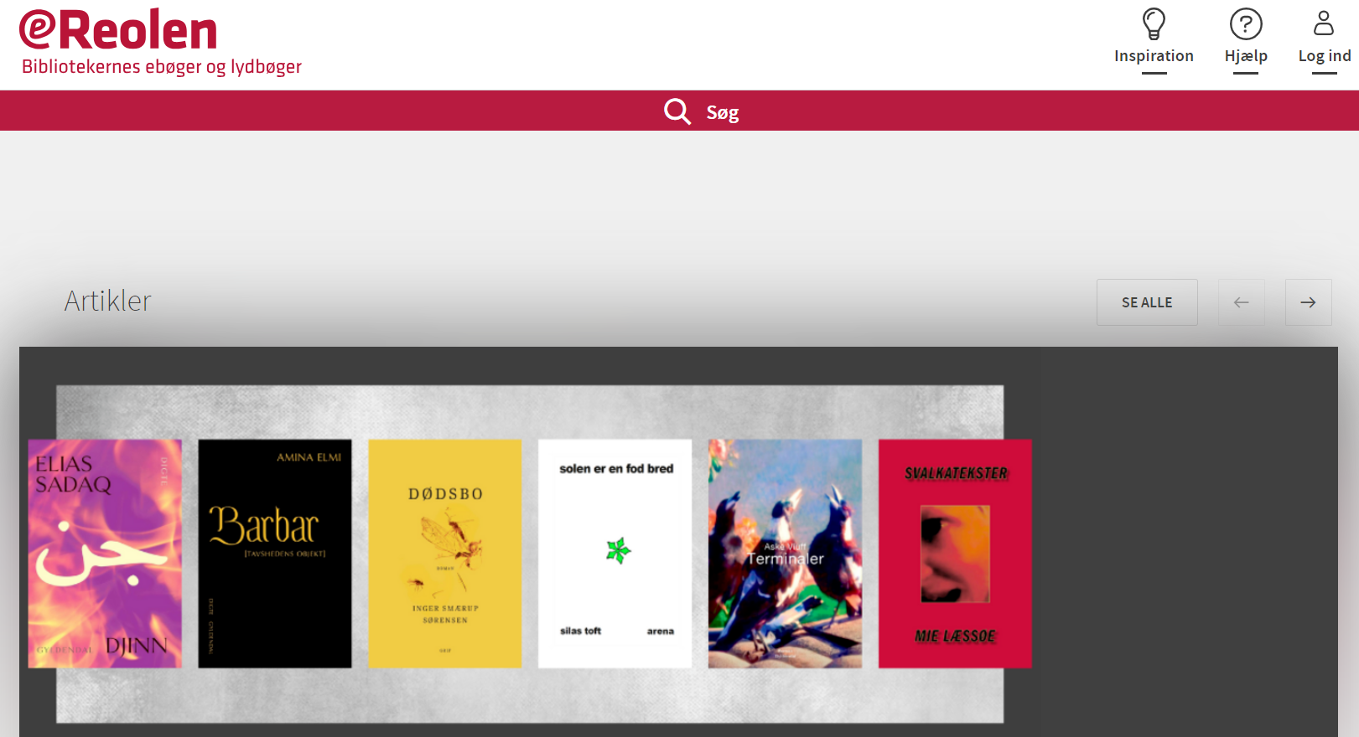
Building an e-lending service
Choosing a distribution platform
Choosing an existing one
Build on something open source
Build it yourself

Slide 11
Building an e-lending service
Choosing a collection
Origin; national language / international
Genres
Formats; ebook, audiobooks, podcasts, magazines etc.
Who is your target group?
PS: AUDIO IS COMING!

Slide 13
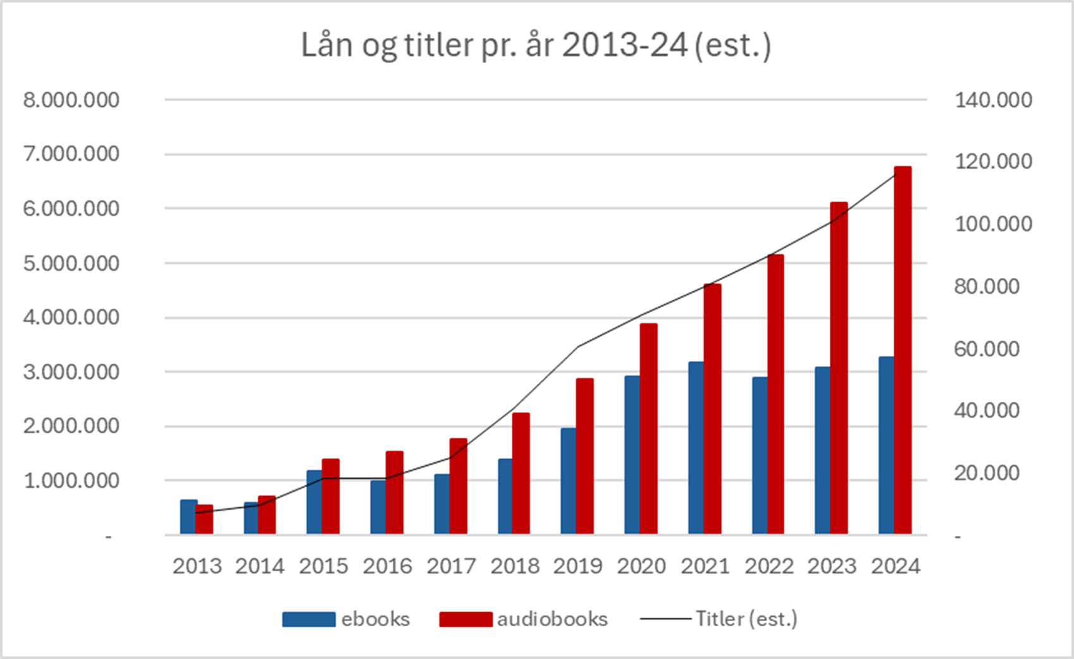
Loans and titles per year Denmark 2013-2024

Slide 14
Necessary friction
Metered access has inbuilt fritction, but can be a hard sell to patrons and especially children
Libraries setting monetary stops e.g. monthly is effective but also a bit depressing
Being a lot more draconian in the nature of the collection and/or target users (We don’t have the Die Hard oeuvre in our movie service for instance)
Other inventive solutions such as making customers come to the physical library for their ebooks

Slide 15
Realisation
When I took over as chief negotiator in 2017:
95-8% of the catalogue we agree on
Publishers need friction and we can’t afford not to have friction anyway
Price, easy access, quality of titles; pick any two
Our editorial team had built up impressive competencies with children’s literature, Danish, narrow and older literature

Slide 16
The big win-win
eReolen has new titles, but they are restricted
It’s a prerequisite for being on eReolen that we get publishers’ new titles and your audiobooks (the new even blacker black)
Not all of them and not on release date, but at a reasonable level
Then we promote (and pay for!) all the publisher’s other titles the news-addicted commercial services aren’t interested in!
We have placed eReolen a different place in the market than our commercial colleagues and we take up 28% of the digital trade market

Slide 17
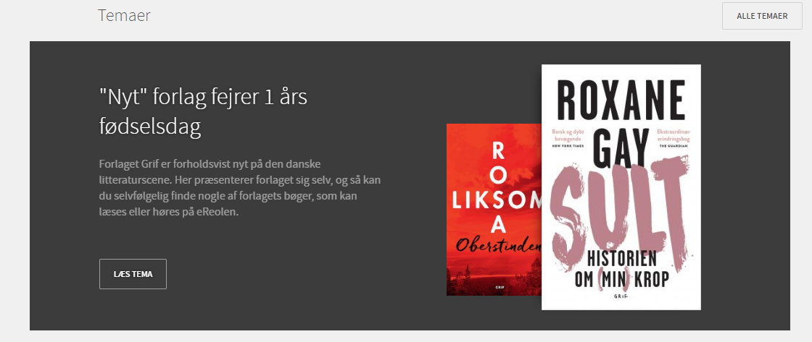
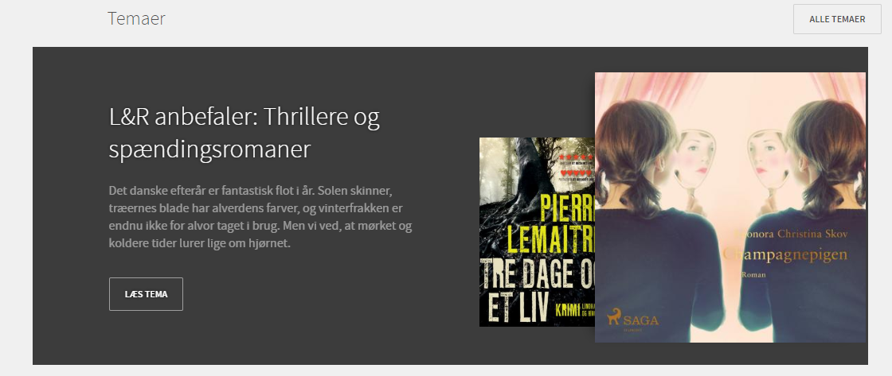
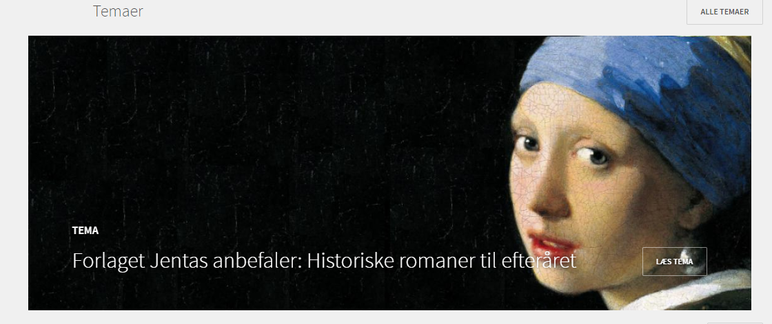
Unique collaboration

Slide 18
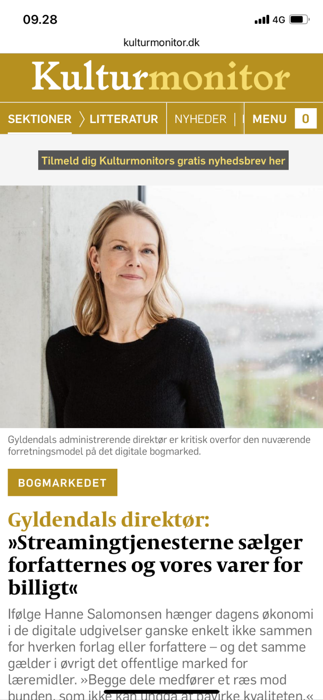
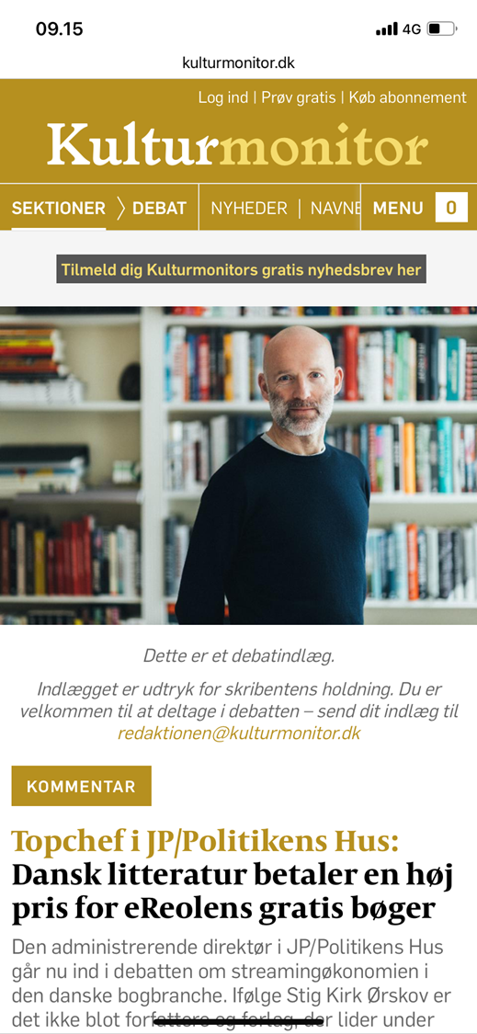
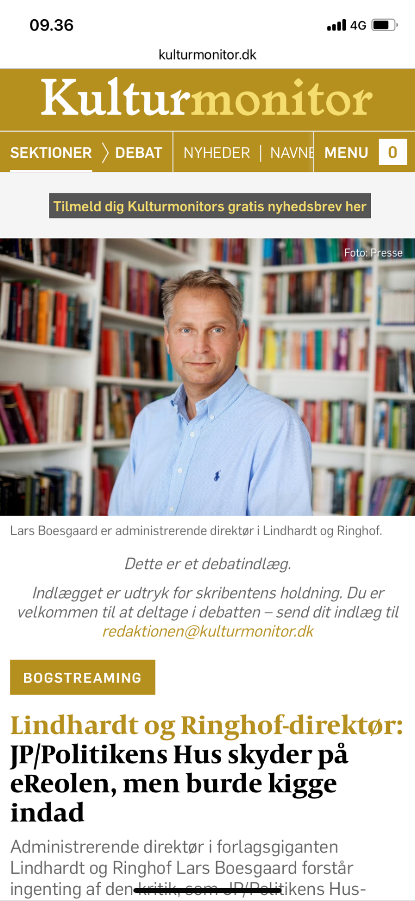

Slide 19
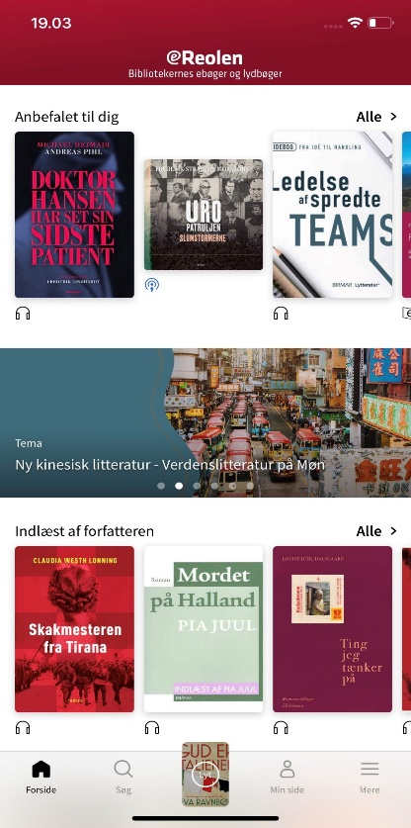
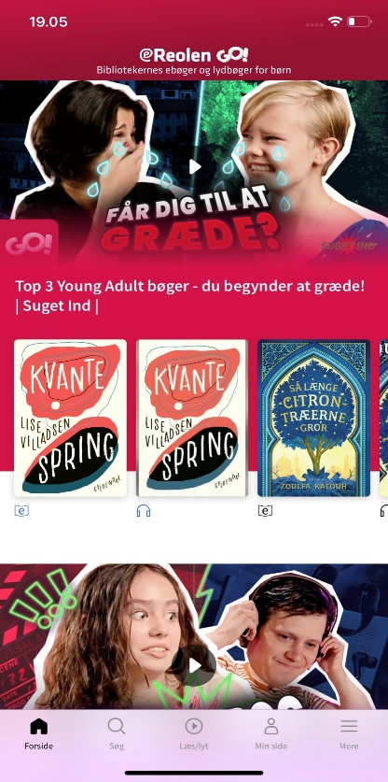
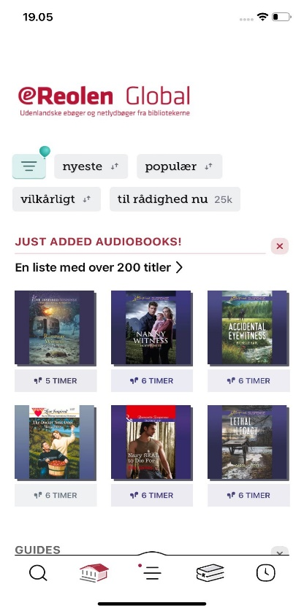
Building an e-lending service
Choosing frontends & integration
Choosing existing ones
Integration with existing infrastructure?
Special frontends for special user groups?

Slide 20
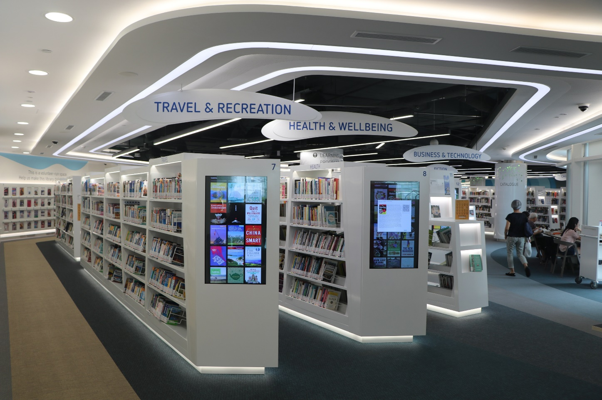
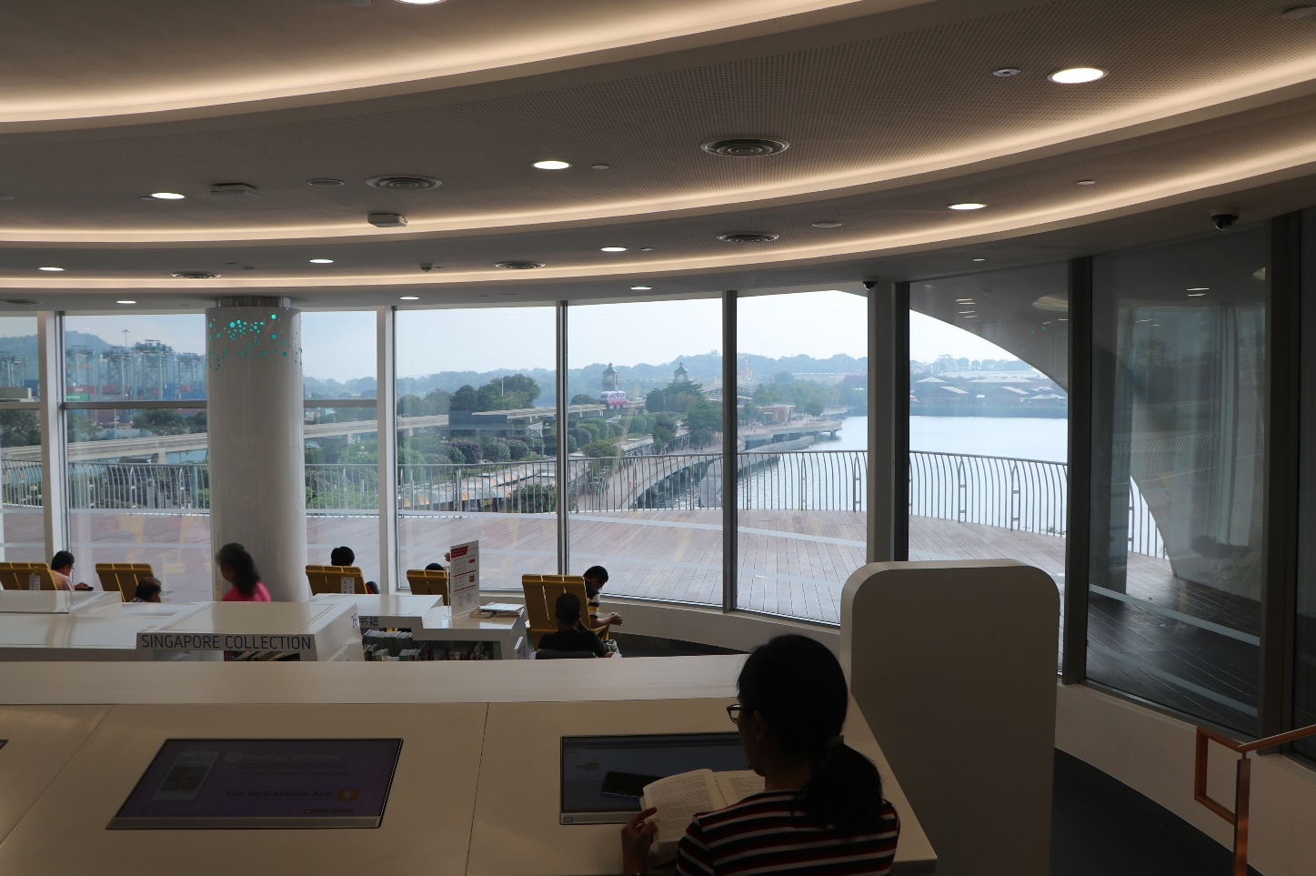
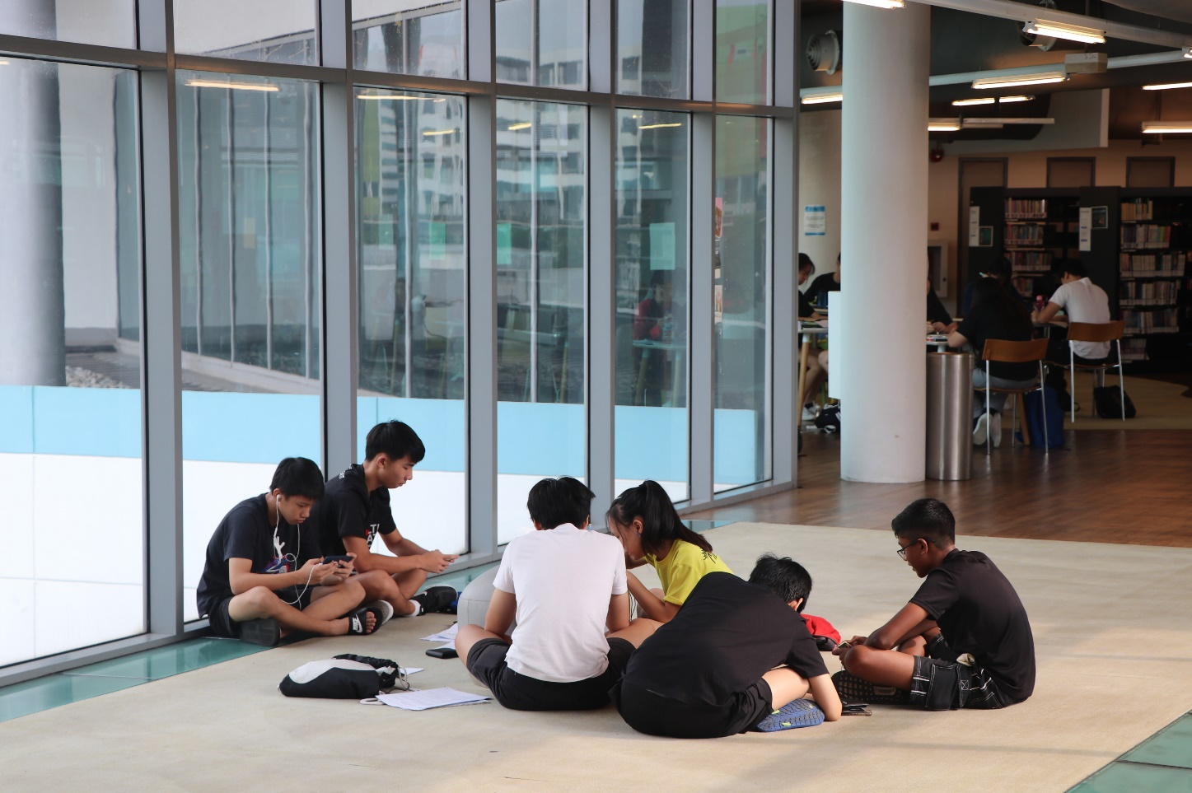
Integration with the physical library

Slide 21
Physical and digital users in Denmark
Both
Strictly physical users
Strictly digital users

Slide 22
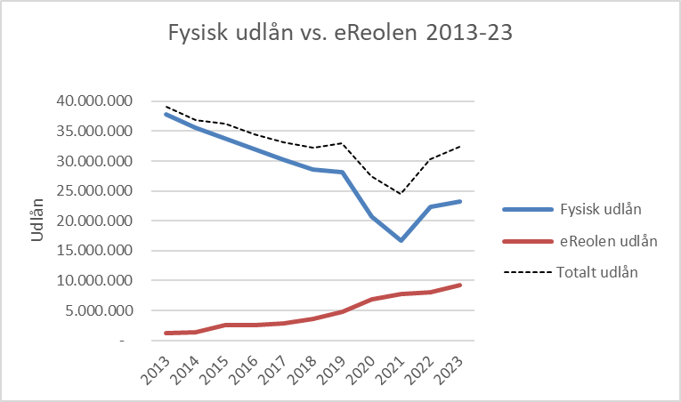
Development in loans Denmark 2013-23
All loans Denmark 2013-23
Physical loans
Digital loans
Total loans

Slide 23
Are we building a digital library or a e-lending logistics app?
I think we need to build a digital library!
I think we can take the physical library into digital space for the good of all!
PS: I also think we have to!

Slide 24
The (digital) library value pyramid

Slide 25
Questions, comments, threats, love letters to: Mikkel.christoffersen@eblida.org +45 2049 1885 www.eblida.org

