Slide 1
Let’s shape future together: Use of AI tools for librarians and library user education
Nikica Gardijan
University of Zadar, Research Library
ngardijan@unizd.hr

Slide 2
(Very) brief introduction
When we say AI, what do we think?
Is it something new?
Why it is so popular?
Where can it be used?

Slide 3
The point of no return
Ray Kurzweil prediction
surpassed in 2015
will be surpassed in 2029
reach singularity by 2049

Slide 4
Grim perspective?
Gen AI tools trained on massive amount of data
Milions of dollars invested in development
Always at our disposal
Even the best among us are becoming obsolete
So, what we are doing here?!

Slide 5
Current state and future development of AI
Human centered AI (Today)
Human on the loop (Future)
Human out of the loop (GAI)

Slide 6
AI tide rising
Notes:
Hans Moravec, our austrian neighbor

Slide 8
AI and libraries
Data
Information
Search process
Knowledge
Information behaviour
LIBRARIANS ARE INFORMATION EXPERTS
Active librarian = equal stakeholder
In school
As a part of community formal and informal learning setting
At university
Notes:
Na kraju ovog slajda možda reći ono za dončića, read and react.

Slide 9
Librarians AI education – Why?
To gain UNDERSTANDING ( what’s behind AI )
To develop POSITIVE ATTITUDE
To ensure PROPER USE

Slide 10
Librarians attitudes towards AI tools
Study conducted in 2024, 6 university libraries, 2 national libraries, 115 respondents ( 62 SLO, 53 CRO )
Overall attitude towards AI: CRO 3.91 SLO 4.15

Slide 11
Items analysis
AI tools can be used in enhancing library services – 4.15
It is neccesary to include AI tools teaching in user education programs – 4.35
Time and resources should be invested in AI training for librarians – 4.35
AI tools will alter the role of librarians – 3.76
Positive correlation: attitudes konwledge use
Notes:
Sad ovdje likertove skale rezultate. Samo za slovence! ( i onda šala, bolji ste u svim segmentima ☺

Slide 12
Librarians AI education – How?
Find suitable lecturer
Design workshop / course together
Two phase approach
Include all employees
Ensure feedback
Provide advanced training
Form in-library AI team
Gain knowledge sufficient enough to make INFORMED DECISION
Notes:
Pristup u dvije faze ne mora biti nužno razdvojen – sve ovisi

Slide 13
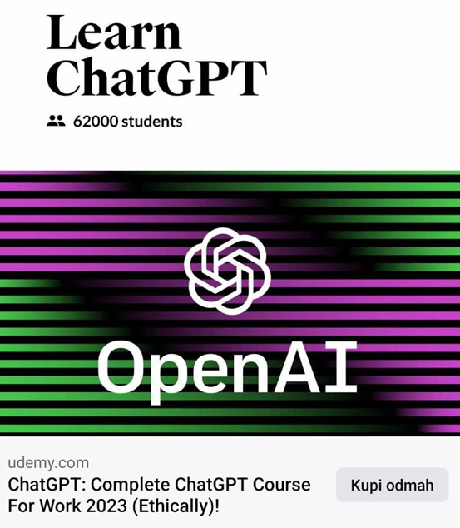
Library user AI education – Who / Why?
Librarians as educators
Opportunity to develop and test our skills on the market
What are our advantages?
We offer comperhensive service!

Slide 14
Library user AI education – How?
Know your audience
Advertise
Custom-made lectures/workshops/courses
Use free AI tools
Ensure feedback
Repeat
Notes:
Zašto mi nudimo sveobuhvatniju uslugu? Jer nismo utilitaristički nastrojeni niti na takav način educiramo naše korisnike. U odgovoru na ovo pitanje se krije i odgovor na pitanje zašto je, po mom mišljenju, od izrazite važnosti to da upravo knjižničari provode AI edukacije. Jer su svjesni kompleksnosti pitanja!

Slide 15
Library user AI education – How?
While creating course, emphasise following:
AI tools tendency to fabricate
Questionable information sources
Overreliance
Importance of AI courses (garbage in – garbage out)
„Small” languages discrimination
Freemium concept
Point out upsides of AI
Ability to conduct a search process, find information, evaluate it and use

Slide 16
Library user AI education – How?
Information literacy course
AI course
Comprehensive information literacy course
(AI embedded)
Notes:
Zašto knjižničar i zašto ovako: jer je knjižničar osoba koja može pružiti SVEOBUHVATNU izobrazbu.

Slide 17
Shaping the future together
AI tools are here to stay – so are the libraries
Nature of our job is changing
AI implementation in library services? – Sure, but on our terms.
Unique role in facilitating informed and responsible use of AI
Promote values of access, privacy, intelectualy property, etc.
Information literacy and critical thinking skills are and will be of utmost importance!

Slide 18
Conclusion
Use AI as a leverage –strengthen your role
Take your place at the desk
Promote human-centered AI
AI is here to enhance, not to replace
Steer the changes!

